Slide 1
Aurora
Women’s Leadership Development Programme
Equality & Diversity July 2024
University of Strathclyde

Slide 2
What is Aurora?
2024
Aurora is Advance HE’s leadership development initiative for women: https://www.advance-he.ac.uk/programmes-events/aurora
It is focused on 4 key areas associated with leadership success: Identity, Impact and Voice; Politics and Influence; Core Leadership Skills; and, Adaptive Leadership Skills.
Runs across UK and Ireland and involves 6 interlinked days, alongside additional social opportunities and special events.
The programme typically runs for 6 months, usually between September and February.
Supports participants and their institutions to fulfil their leadership potential through thought-provoking activities, collaborative problem solving activities and motivating stories supported by inspirational women role models.
Why women only? Aurora is an example of positive action provision to address underrepresentation of women in leadership roles.

Slide 3
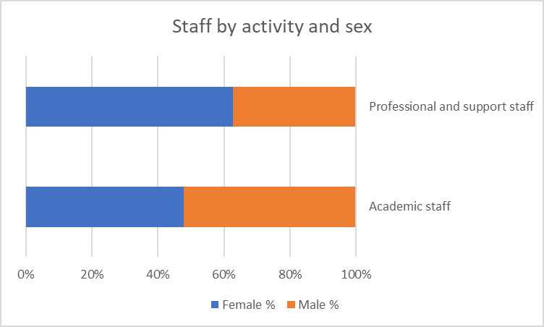
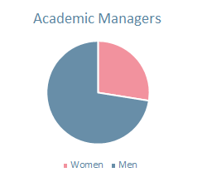
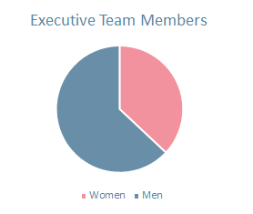
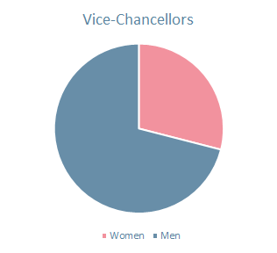
Sector context
2024
Source: Equality in higher education: statistical reports 2023
Onwards and Upwards? Final report for leaders and policymakers on the Aurora Longitudinal Study, Advance HE, 2021

Slide 4

Igniting leadership
2024
Learn Tools, techniques and strategies from a team of leadership experts​, guest speakers & online resources
Develop Leadership skills through experiential processes, reflection and conversations
Network Meet delegates through live development days with interactive breakout sessions and two action learning set meetings
Connect With a UK wide network through a members only group
Grow Supported by a mentor provided by your institution​.

Slide 5
Aurora Impact
2024
Aurora – the longitudinal study
5 year study (2015-2020) conducted at University of Loughborough
explored context of women in leadership in HE, as well as views and progression of Aurora participants.
8.6% of Aurorans said they had been promoted compared with 7.1% of comparison group.
25.1% of Aurorans reported receiving an accelerated or discretionary increment compared with 16.1% of the comparison group.
Three years or more after Aurora, Aurorans were more likely than comparison group to report receiving an increment in the last 12 months.
Qualitative responses were overwhelmingly positive, with many highlighting increased self-confidence in abilities and capabilities.

Slide 6

Who is Aurora for?
2024
Aurora is for women, up to senior lecturer level or the KE / research / professional services equivalent (typically grades 7-9) who would like to develop and explore issues relating to leadership roles and responsibilities.
If you have not done any substantial leadership development training, this programme could be for you.

Slide 7
Who is Aurora for?
2024
You should be committed to developing and enhancing your career and:
Attending each of the four development days, and the two action learning set days organised by participants in their assigned groups;
Undertaking self-directed learning throughout Aurora;
Committed to working with a mentor who is provided by their institution;
Prepared to access leadership opportunities and champion for change

Slide 8
Aurora format
2024
2024/25 dates are:
Thursday 26 September 2024
Friday, 25 October 2024
Friday, 15 November 2024
Thursday, 21 November 2024
Tuesday, 10 December 2024
Friday, 17 January 2025
Scottish cohort drawn from institutions across Scotland
Aurora is delivered predominantly online with some optional in-person events

Slide 9
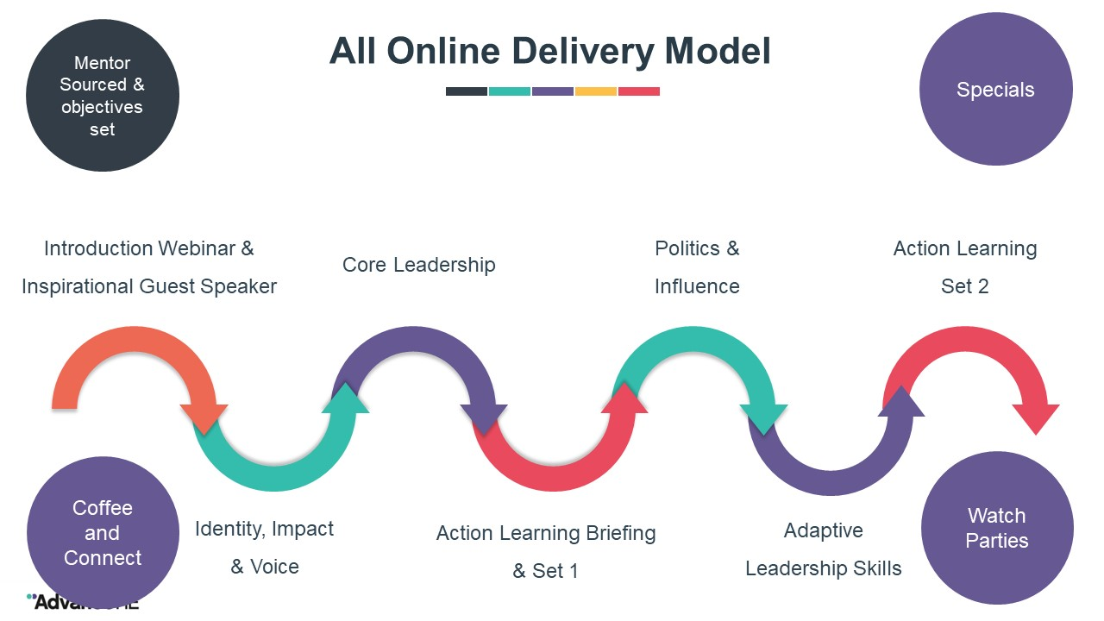
2024

Slide 10
Aurora at Strathclyde
2024
Strathclyde centrally funds a limited number of places each year via the Equality & Diversity Office. Departments can also locally fund additional places for their staff.
There will be approximately 15 centrally-funded places in 2024/25. Over 145 places have been funded by the University since 2013!
You will have access to mentorship for the duration of the programme – and you will receive support to match you with a mentor at Strathclyde.
There will be opportunities to meet and connect with other Strathclyde colleagues taking part in Aurora, and opportunities to get involved in related events and activities.

Slide 11
How to apply
2024
For a centrally-funded place at Strathclyde
Look out for information in Inside Strathclyde in summer
Complete the short application form
Obtain endorsement from your line manager
Submit the completed form – there will be an internal deadline for your application
The selection panel will consider applications then notify applicants of outcomes
Further information and guidance will be circulated by the Equality & Diversity Office

Slide 12
Application Guidance
2024
Information to support your application for a centrally-funded place
The following section provides information about the application form – including information on what to consider and the kinds of things to include when completing the form.

Slide 13
Selection Criteria
Applications will be assessed on how they adhere to the below criteria and application word count. Applicants should be:
in an academic, research, teaching, knowledge exchange or professional services role, usually between grade 7-9.
interested in developing their leadership skills in order to further their career, particularly with regard to leadership skills and progression into a future leadership role (Application Question 2)
able to demonstrate that participation in the Aurora programme specifically would benefit their future career aims and the aims of their department/the University (Application Question 3)
able to demonstrate a record of applying learning from training or development opportunities to current or past job roles (Application Question 4)
able to demonstrate that this is an appropriate time for them to participate in Aurora (in terms of career point, ambitions and learning and development to date) (Application Question 5)
Scoring:
0 = does not meet criteria
1 = partially meets criteria
2 = fully meets criteria
3 = exceeds criteria

Slide 14
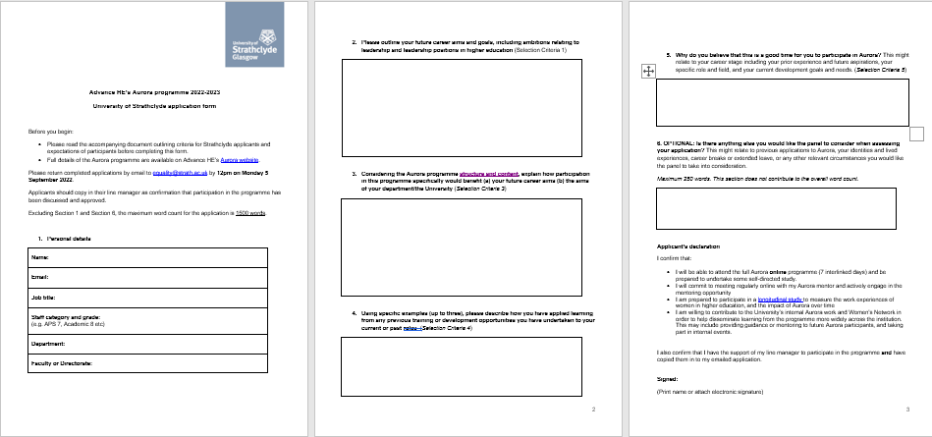
Application Form

Slide 15
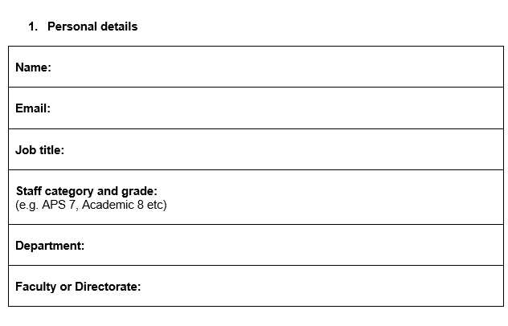
Identifying information redacted before scoring
SC2. in an academic, research, teaching, knowledge exchange or professional services role, usually between grade 7-9.

Slide 16
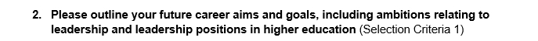
What would you like the next step in your career to be?
Why do you want to make move to a leadership role?
What does leadership look like for you within that ambition?
What would you like to change/influence for the better?
What are you currently doing and what have you done so far towards taking on more leadership?
Have you taken on additional responsibility, already leading a small team, taking part in committees or groups?
Are you not sure how to go about this and Aurora could help?
it’s okay to not know exactly
SC 2. interested in developing their leadership skills in order to further their career, particularly with regard to leadership skills and progression into a future leadership role

Slide 17
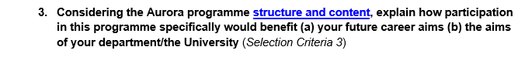
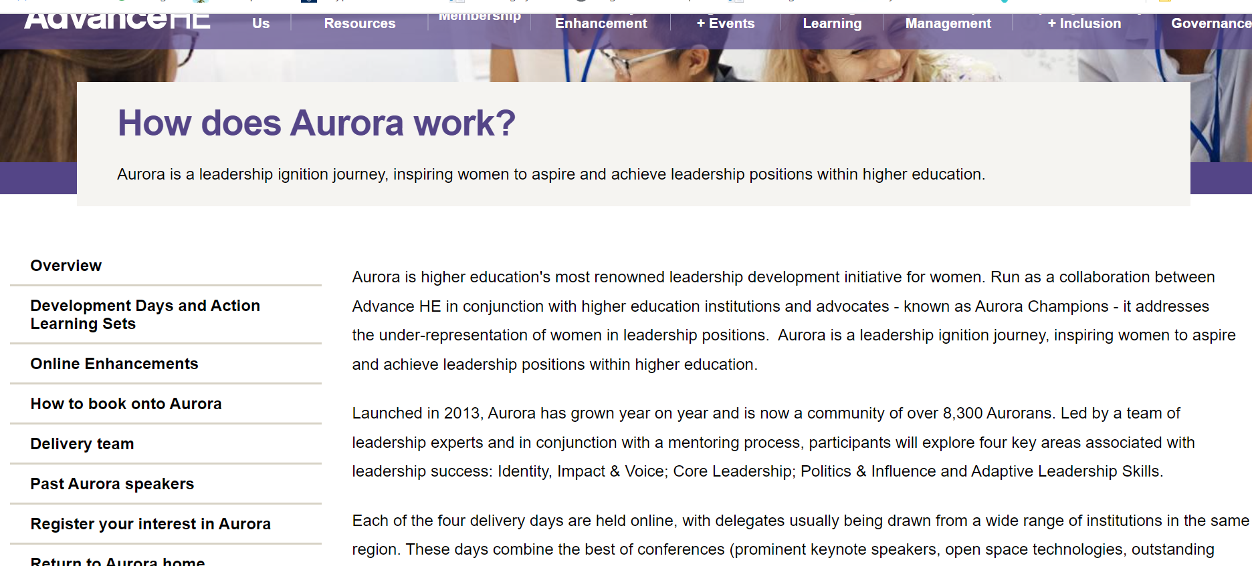
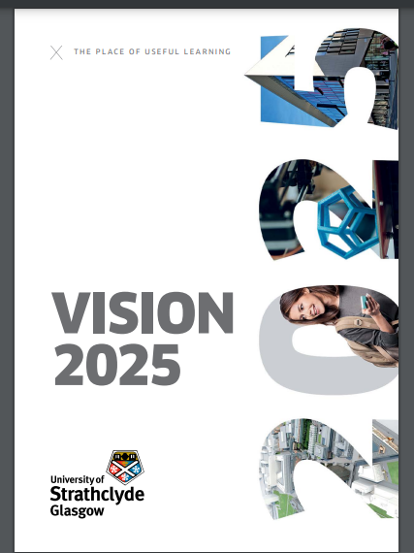
Spend some time looking at the information about Aurora and the Department/School/University aims
a) future career aims
How do you see the topics covered and opportunities provided supporting your leadership vision provided in Q2
What can you not do now that these will help you to do?
b) aims of the Department/School/University
How do you see the topics covered and opportunities provided supporting these aims or helping you to achieve them?
Make direct, explicit links rather than generic “it will help me be a better leader”
SC3. able to demonstrate that participation in the Aurora programme specifically would benefit their future career aims and the aims of their department/the University

Slide 18
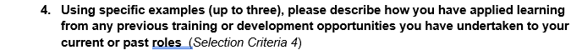
Want to see that you make the most of learning opportunities
What was the opportunity?
What learning have you applied and how?
What has changed for you/your department/school/university because of it?
State explicit outcomes eg better able to support colleagues, more confident, changed a process, etc
Egs of workshops, development programmes etc work best here
Think about this using the Situation, Task, Action, Result approach (focus on Action & Result)
SC4. able to demonstrate a record of applying learning from training or development opportunities to current or past job roles

Slide 19
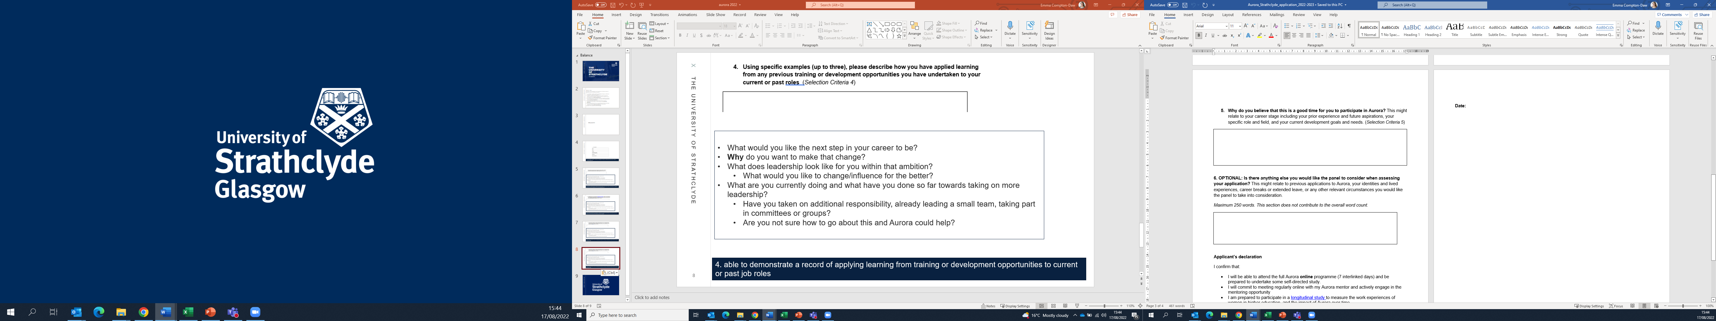
Why now?
How will Aurora help you move to your next role?
Demonstrate you are ready to take the next step
What have you done already?
How have you changed your current role to mean you’re ready to take the next step?
Detailed responses more helpful than generic
“I need leadership skills and now is a good time” or “it’s a great opportunity and I’d like to do it”
SC5. able to demonstrate that this is an appropriate time for them to participate in Aurora (in terms of career point, ambitions and learning and development to date)

Slide 20
This optional section enables you to reflect on any personal circumstances or experiences you wish the panel to take into consideration.

Slide 21
Focus on leadership not operational detail
Give explicit examples – what does leadership look like for you, what will you change, do differently, lead…
Show you have thought about your leadership development and how you will make the most of this opportunity

Slide 22
Thanks for reading
If you have any queries, please contact equality@strath.ac.uk
2024

