Slide 1

Finance Forum
March 2019

Slide 2

Welcome

Slide 3
Agenda
Welcome & Introductions | Clare Urquhart | 1400-1405
Finance structure & new communication routes | Clare Urquhart | 1405-1430
Points to Note | Gary Fleming & Clare Urquhart | 1430-1445
VAT Matters | Jude Billcliffe | 1445-1455
Procurement Matters | Barry Allardice | 1455-1510
Research Matters | Sandy Hall | 1510-1520
FMS Update | Kathleen Boyle | 1520-1530
Training Update | Clare Urquhart | 1530-1540
Workshop Session 1 New Supplier Process | Barry Allardice & Dawn Hitchens | 1540-1620
Workshop Session 2 Key FMS Reports | Kathleen Boyle | 1540-1620
Q & A | Finance Team | 1620-1630

Slide 4

Hugh Darby
Director of Finance
Kirsty MacLeod
Deputy Director of Finance
Accounting Services
Hugh Darby
Act Chief Financial Officer
Post-award Research Contract Mgt
Courses & Conferences
Consultancies
Other Knowledge Exchange
Sandy Hall
Research Contracts Manager
Research Finance
Payroll
Pensions
Finance Operations
Finance Helpdesk
Clare Urquhart
Deputy Director of Finance
Finance Operations
Finl A/cing+Rpting
Stat A/cing+Rpting
Statistical Returns
Treasury Mgt
PS Mgt A/cing
Capital Accounting
Budgetary Control
Project Appraisal
Laura Colquhoun
SBS
New BP HaSS
Finance Business Partners
Paul McShane
Financial Systems Manager(ISD) Business Systems - Finance
Systems Support
Systems Development
Online Shop
Beth Lockhart
Science
Fiona Hart
Engineering
Fiona Hughes
Head of Procurement
Procurement
Procurement
Supplier Masterfile
Finance Training
Jenny McLeod Estates
Overview of Finance

Slide 5
Accounting Services
Kirsty MacLeod Deputy Director
Kathleen Boyle Finance Mgr
Jude Billcliffe Financial Acc
Catherine McFarlane Mgmnt Acc PS
Jennifer Atkinson Mgmnt Acc PS
Elaine Marioni Senior Acc Asst
Sun-Mei Younis Senior Acc Asst
James O’Neill Mgmnt Acc
Kris Muircroft Financial Systems Analyst
Adam Greer Senior Finance Asst
Gillian McDougall Senior Finance Asst

Slide 6
Finance Operations
Clare Urquhart Deputy Director of Finance
Banking Team Lynne O’Reilly
Helpdesk Caroline McVey
Helpdesk Advisor x 7
Income Collection Team Catherine Grant
Linda Chau Senior Finance Asst
Payments Team Dawn Hitchens
Michelle Lewis Senior Finance Asst
Lynne Gammie Senior Finance Asst
Payroll Officer Gary Fleming
Sandra Higgins Deputy Payroll Officer
Donna Morris Senior Payroll Asst
Pensions Officer Fiona Saunders
Pauline Paddison Asst Pensions Supervisor
Jan Gray Finance Asst
Vivienne McDougall Payroll Asst
Karen McNulty Senior Finance Asst
Finance Asst (vacancy)
Lorraine Gordon Finance Asst
Joanne McBrearty Finance Asst
June Thomson Senior Finance Asst
Donna Thomson Senior Finance Asst
Georgina McNee Finance Asst
Jack Easdon Finance Asst
Student Funding Team Carole Muir
Senior Finance Asst (vacancy)
Pauline Rooney Payroll Asst
Moira Kennedy Payroll Asst
Margaret Cameron Finance Asst
Senior Finance Asst x 2
Finance Asst x 1
Helpdesk
Transaction Processing
Payroll & Pensions

Slide 7
Research Finance
Sandy Hall Research Finance Manager
Linda Tuzcu Assistant Research Finance Manager
Katie Edward Assistant Research Finance Manager
Callum Nettleton
Other
Sharon Gibson
RCUK/ ATA
Michael Bonner
RCUK/ Project opening
Alastair Harvey
Knowledge Exchange
Julie Rattray
EU
Gordon Garrow
EU
Amanda Hart
KTP
Frances Hudson
Innovate UK
Andy McDougall-Andrew
Other
Notes:
The role of the team is to provide guidance to the Research Community based upon funder specific contract requirements and the University’s financial regulations and expense guidelines. The team is working to daily deadlines driven by funder claim profiles with approximately 70% of the Teams time is focused on external funder requirements and audits.
Current Structure put in place following the Finance realignment in 2017.
Following realignment, 3.5 FTE from the original team remained.
Training and cross-skilling has been a primary focus for the team in order to maintain the University’s audit record with external funders such as the European Union and Research Council UK. Standard operating procedures have been put in place to assist with training.
Since the restructure we have increased our audit ranking with RCUK to the highest possible level, and achieved a 0% error rate on an Interreg audit (the first in the UK).

Slide 8
Business Partners
Hugh Darby Director of Finance Deans
Fiona Hart Engineering
Beth Lockhart Science
Danuta Edyta Kuc-Maciejewska Asst BP
Laura Colquhoun Business
Sarah Alvi Asst BP
Lynda Kelly Asst BP
New BP HaSS
Lindsey McGonigal
Jenny MacLeod Estates
Lorna Richardson

Slide 9
Financial Systems
Paul McShane
Financial Systems Project Manager
David O’Neill Systems Analyst
Tracy Bennett Financial PCI Compliance Officer
Graham Disley Aileen Houston Applications Analyst/Developer
Calum Campbell Pauline Johnstone Systems Administrator
Kris Muircroft Financial Systems Analyst

Slide 10





Customer Service……….

Slide 11

Finance Helpdesk
Caroline McVey Act Helpdesk Manager
AnnMariee Kerwick
Gail Roberstson
Kirsty Williamson
Rosie Kiely
Jennifer McNaught Helpdesk Advisors
Clair McClelland
Pauline Mitchell
Helen Tracey Senior Finance Assts
Alison Escobar
Anne Miller Finance Asst

Slide 12

The Team

Slide 13
New mailboxes from 7 May 2019

Slide 14


Slide 15


Slide 20

Points to Note

Slide 21
Income Collection:
Points to Note
Purchase Order Numbers on Sales Orders
Many Customers now requesting that their PO number is inserted on our sales invoice to ensure payment is made
PO number gives a commitment from the customer to pay us
Company Supplier Forms
University bank transfer information is contained in How To Pay
As a general rule the University’s Bankers do not issue bank references
Notes:
IAS interest in Credit checks before a Customer is placed on FMS

Slide 22
Student Funding:
Points to Note
Sub project needs to be identified for all scholarships before Finance can apply this to the students record
Update the PGR with tuition fees and stipend information as soon as this is available to allow a smooth registration for the student
Check sub project and activity codes are correct and that the sub project has not been parked
If making changes to sub projects after tuition fees/stipend have been charged - complete a journal upload template, including student ID, and send this to your Assistant Business Partner for processing (note student ID can’t be entered in journal entry screen but is required for journals relating to fees/stipend
Notes:
Need to identify the chargeability as early as possible so that the true financial picture can be seen overall

Slide 23
Payments: Points to Note
RFP form needs to be completed online
Completed ESS should be attached to the RFP form (date of completion & who completed ESS also recorded)
ESS should be attached to the request for a New Supplier ( where applicable)
Where receipts are missing from an expense claim this should be flagged ‘No Receipt’

Slide 24
Payments: Points to Note
Must change the status of an Expense claim from Draft to Ready on the Summary tab and then Save the claim (see FAQ in Expenses section of Hub)
See guide ‘Close a Requisition’
If you wish to check where an Expense is in workflow or who approved an Expense use the Workflow Enquiry – Travel expenses under the Time & Expenses menu item
If you wish to see the detail of previous Expenses, use the Expenses enquiry under Your Reports, Expenses
Remember – your Supervisor using you as their Substitute – alert to Financial Systems

Slide 25
Banking: Points to Note
Any Unspent advances to be repaid via Bank Transfer (quoting FMS advance nos) and send confirmation email to Banking Team
Ongoing review of Petty Cash - alternatives currently being looked
Better use of online shop? – sale of notes/equipment/materials
No cash payment facilities in Finance

Slide 26
International Payments:
Points to Note
International Payment Proposal run (FMS enabled suppliers)
File upload from FMS onto Payment Portal (Cambridge)
Proposal approved on Cambridge by Authorised signatories
Payment ‘push out’ by Cambridge
Intermediary Bank 1,2……
Payment received by beneficiary bank

Slide 27
International Payments:
Points to Note
International Payment Proposal run (Sundry Suppliers)
Transactions input onto Payment Portal (Cambridge)
Proposal approved on Cambridge by Authorised signatories
Payment ‘push out’ by Cambridge
(email to initiator)
Intermediary Bank 1,2……
Payment received by beneficiary bank
Notes:
Notification from

Slide 28
International Payments:
Points to Note
International Payment Charges
Charging options are applicable depending on where the payment is being sent.
Current options are:
SHA - Sender and Receiver share the charges . The Sender pays their own bank charges . The Receiver pays their own bank charges plus those of any bank involved in processing the payments
BEN – The Receiver pays all charges
OUR – The Sender pays all charges

Slide 29
International Payments:
Points to Note (cont)
If the payment is being sent within the EEA then the charging option is restricted to SHA
The University’s default position for all international payments ( including those out with the EEA) is also the SHA option
This is also aligned to the University’s Conditions of Contract (section 10.5) that all FMS suppliers have to sign up to, before being created on FMS
Depts need to flag to Finance Helpdesk where exceptionally an alternative to SHA is required

Slide 30
Intermediaries Legislation (IR35):
Points to Note
Introduced April 2017
Employment Status for tax purposes (ESS)
University makes assessment
Outcome drives payment method
Payment route (no deductions)
Payroll route (with deductions)
Different outcomes per dept possible
Ltd Companies can be ‘caught’ by the legislation
Notes:
New Supplier Process & RFP

Slide 31
Projects: Points to Note
You can change the Sub Project manager if you have access to the Sub Project Masterfile in the Project Management menu item.
If you don't have access check with your department administrator to identify which staff in your department have this
If you have access to the Project Management menu you can check the Sub Project masterfile.
Otherwise you can use the report Sub project information (excl. Estates) under Your Reports, General Informaton, Lists of Codes

Slide 32
Payroll : Points to Note
Supplementary Payroll Claims
Online completion deadline
Online Payslips
  Secure Portal
  Datagraphic Ltd

Slide 33
Payroll : Points to Note (cont)
PAYMENT FORMS
P1, P2 and P3
P1 – Multiple Staff Fees/Overtime
P2 – Individual Staff Fees/Overtime
P3 - Guaranteed Hours
DEADLINES
P1 & P2 Forms to HR by 5TH of month
P3 forms to Payroll by 5TH of month

Slide 34
Payroll : Points to Note (cont)
Forms need to be authorised by Sub Project Manager or HoD
Please quote 23 digit code ( Payroll not on FMS)
P3 forms are prepopulated
  Must only be used when a contract has been issued
  Timing can delay issue of form
  Blank form available on Finance web pages

Slide 35
AMS: Points to Note
Self certificates and returns should be sent directly to the monthly.absence.returns@strath.ac.uk. No requirement to follow on with a hard copy
Ensure medical certificates/self certificates are sent when received and not held over to be sent with the monthly return
Ensure the return is sent on time -deadline is 4th of the month

Slide 36
Pensions: Points to Note
Contribution Rates
Start of new pension scheme year from1 April 2019
Contribution rates are increasing or subject to review
USS contribution rates are increasing for all members & employers with effect from 1 April 2019
The changes are:
Employee rate increases from 8% to 8.8%
Employer rate increases from 18% to 19.5%

Slide 37
Pensions: Points to Note (cont)
Contribution Rates (cont)
Local Government Pension Scheme
Employee rate - reviewed at 1 April 2019
The rate for the 19/20 scheme year is set individually for each member by reference to their annual salary as at 1 April 2019
The higher the annual salary the higher the contribution rate.
Employer rate – stays the same at 29.5%

Slide 38
Pensions: Points to Note (cont)
Auto-Enrolment
Every three years the University is required to review the position for all employees not currently a member of a pension scheme offered by the University
The review date this year is 1 May 2019
Depending on age and salary received in May a member of staff may be automatically enrolled into USS or LGPS with effect from 1 May 2019
They will be informed by email if this is the case and can opt out if they wish
Ill Health Retirement – early contact with HR and Pensions Team

Slide 39

VAT Matters
Introduction
Purchase VAT – Guide and common issues
Sales VAT – Guide and common issues
Where can you find guidance and who can help?

Slide 40
Guide – Purchase VAT
Requisition/purchases
Which tax code should I select when I raise a requisition?
When raising a purchase requisition, the amount is entered net and the tax code is derived from the product, e.g. PS for standard rated products.
Key Tax Codes: | Description | Rate
PS | Purchase (input) – Standard Rate | 20%
PZ | Purchase (input) – Zero Rate | 0%
PR | Purchase (input) – EU & OS Services Reverse Charge | 20%
PE | Purchase (input) - Exempt | VAT Exemption
PL | Purchase (input) – Lower Rate | 5%
0 | Out of Scope –Non-business | Not in VAT system

Slide 41
Common Issues/Queries
Requisition/purchases
PS – Standard rate - 20%
This is used when we buy standard rated goods/services from a UK VAT registered supplier.
PZ – Zero rate - 0%
This is used when we purchase goods that are set at 0% for VAT by HMRC, for example books/ magazines, basic foods etc. Overseas goods also fall into this category as the VAT is captured when the goods come through Customs, the vat is paid by our courier and we then repay the courier.
PR – EU Goods/Services & Overseas services only reverse charge - 20%
When we purchase goods/services from an EU supplier the invoice will not include VAT. This is because the VAT becomes the customer’s liability rather than the suppliers. This is only applicable if the goods/service would normally fall under the standard rate category.
PE – Exempt – VAT Exempt
This is used when we purchase goods/services that are classed as VAT exempt by HMRC, a few examples would be medical/veterinary supplies, subscriptions, training/teaching provided to the University students by eligible bodies, i.e. other universities/colleges.
PL – Lower rate – 5%
This is used when we purchase goods that are at a reduced rate for example domestic fuel or power, children’s clothes etc.
O – Out of scope – Not in VAT system
This is used when we purchase goods from a non-VAT registered supplier or for charges for non business purposes for example donations, grant etc. This is also used for internal journal transfers.

Slide 42
Common Issues/Queries
Requisition/Purchases
Why is VAT charged when I buy goods/services from Overseas and EU suppliers where no VAT has been charged in the invoice?
Many purchases from EU and Overseas Purchases are under VAT reversal mechanism (Reverse charge), by applying PR (VAT reversal) Tax Code, FMS will be able to split VAT and net payment i.e. we pay supplier the Net amount and VAT is debited to your budget and the credit goes to HMRC in the quarterly VAT return.
I have amended the Tax Code to PE and the requisition is approved, why did the supplier still charge VAT?
This could be an error at the supplier’s side as not all Suppliers can download the attached Medical Exemption certificate, if you are charged VAT due to the missing VAT exemption certificate, it is the purchaser’s responsibility to provide the supplier with a copy of the exemption certificate (forms can be downloaded from the Knowledge Hub/VAT webpage).

Slide 43
Common Issues/Queries
Requisition/Purchases
What happens when the supplier disagrees with the VAT exemption application?
It is the purchaser’s responsibility to communicate with the suppliers and provide them with required information to help them make a sound judgement on VAT, if in doubt, contact Finance for help. However if the supplier doesn’t agree with the VAT exemption, we still have to pay their invoices (including VAT) as VAT relief is at the supplier’s discretion.
Why is my requisition rejected when I’ve amended Tax Code from PS to PE for medical exemption? This may be because:
the items you buy do not qualify for VAT exemption – not all items are eligible for VAT exemption. Most common allowable items are consumables for the lab, these are specified by HMRC.
the sub project paying for the purchase is sponsored commercially and VAT is fully recoverable from the normal VAT return – therefore VAT is not an extra cost and there is no need to apply for VAT relief.
your requisition has more than one line but you have only amended the Tax Code on the first line of your requisition, you have to ensure all lines are amended.

Slide 44
Guide – Sales VAT
Sales
Which tax code should I select when I raise a Sales Invoice?
When a sales order is raised in FMS, the tax code is generated by the Sales product, e.g. SS for standard rated products.
Key Tax Codes: | Description | Rate
O | Sales Outside Scope of VAT | 0%
SE | Sales (output) VAT Exempt | VAT Exemption
SS | Sales (output) Standard Rate | 20%
SL | Sales (output) Lower Rate | 5%
SZ | Sales (output) Zero Rate | 0%

Slide 45
Common Issues/Queries
Sales
O (Out of scope) Sales not made in the course of Business
Examples - Internal charges, sales orders sent to funders for donation, grant, cost reimbursement etc.
SE (0%) Sales (output) VAT Exempt - 0%
Examples - including education (course, conference, vocational training, CPD course, workshop, seminar), finance, insurance etc.
SS (20%) Sales (output) Standard Rate - 20%
Sales- VAT charged on goods/services which do not fall into the other categories
SL (5%) Sales (output) Lower Rate - 5%
Sales - including fuel and power used in homes and by charities
SZ (0%) Zero Rate - 0%
Sales - on most food (but not restaurant or takeaway meals), children’s shoes and clothing, books and newspapers and sales to certain overseas and EU business customers for goods and services

Slide 46
Common Issues/Queries
Sales Orders
Can I change the Tax Code when I raise an invoice to a UK customer?
Yes. When a Sales Order is raised in FMS, the tax code is populated by the Sales Product. Where there is a choice of VAT treatments, for example if the ‘customer’ is a student, the appropriate product code should be selected.
When the Tax Code is changed, a workflow is generated to the VAT approvers.
Do I always need to charge customers with VAT?
No. In general, when we invoice a customer for business purposes, we charge VAT.
However in many cases, we charge customers for non-business purposes, i.e. sales orders sent to funders for donations, grant, cost reimbursement etc., which is outside of the scope and therefore Tax Code should be O.
This happens often with Sub-Projects where the Tax System is NR (Not-recoverable for VAT)

Slide 47
Common Issues/Queries
Sales Orders
Which Tax Code should I use when invoicing an EU VAT registered customer?
Invoice to an EU VAT registered customer is under Tax Code SZ (i.e. no VAT charged), based on the condition that we have already set up the customer master file with the supplier’s VAT registration number.
When creating the Sales order please insert the EU Customer’s VAT registration number in the ‘Additional product information’ area in FMS along with the following text:
Recipient is liable for VAT under the reverse charge
Mechanism/Article 196 of Council Directive
2006/112/EC
Note: This may be changed after Brexit
Which Tax Code should I use when invoicing an EU Non-VAT registered customer?
For an EU Non-VAT registered customer, we would normally use standard rate, however, exception may apply depending on the status of the customer, i.e. VAT exemption applies to the supply of goods or services to various International bodies - European Central Bank/ European Investment Bank etc.

Slide 48
Common Issues/Queries
Sales Orders
What are Bench Fees and which Tax Code should I use when invoicing Bench Fees?
Bench fees are charges in additional to Tuition fees these are charged when a programme incurs specific extra costs such as specialised laboratory or field work.
Tax Code | Sales Product | Charge To
SE | SALE036 Bench Fee – Student/Sponsor | Charge to students from other universities (All students worldwide). Sponsors who have exemption status (i.e. Embassy) are also exempt.
SS | SALES037 Bench Fee – Commercial | Non-student, individual researchers, researchers from a commercial company.

Slide 49
Where to find guidance
More detailed VAT information can be accessed in Pegasus by following the link below:
https://www.strath.ac.uk/professionalservices/finance/financialservices/valueaddedtaxvat/
Key Contacts
If you don’t find an answer to your query from the above guidance then please send an email with your question/query to the VAT mailbox:
vat.enquiries@strath.ac.uk
Or contact Sunny Younis (x 2781) or Jude Billcliffe (x 2768)
Notes:
Forum for providing general feedback, raising issues
Two meetings to date, aim to meet every couple of months

Slide 50

Procurement Update
Finance Forum
Barry Allardice, Procurement Systems Manager
March 2019

Slide 51
Team Update
Finance related updates
General updates
Procurement Workplan
Procurement Contacts

Slide 52
Head of Procurement
Fiona Hughes
Procurement Manager
Sharon Griffin
(Professional Services)
Procurement Systems Manager
Barry Allardice
Category Manager
Lauren Leitch
(Estates)
Procurement Officer
Magda Bamford
Procurement Officer
Denise Kyle
Procurement Assistant
Maureen McMillan
Procurement Admin Assistant
Sarena Reid
Procurement Assistant
Kimberley McNee
Category Manager
David Waddell
(Labs and ICT)
Category Lead
AFRC
Sharon Wallace
Senior Procurement Specialist
Neil Grant
(temp APUC).
Procurement Officer
Vacant
Procurement Assistant
Mikaela Bennett
(temp APUC).
University of Strathclyde Procurement Team Structure March 2019

Slide 53
Update part 1
No PO No Payment
  Implemented to ensure:
    All orders are raised and approved through the Financial Management System
    all suppliers received an authorised order prior to receipt of goods and services
    All invoices were received electronically to FMS Supplier Invoices inbox and action appropriately and timeously
  Update
    Improvements noted
    Not at 100% compliance
    Invoices received without a PO will no longer be processed and shall be returned to the supplier
Requests for Payments
  List of true exemptions now in place (Prize Money, Childcare payments, refunds)
  Process covers all payments including RKES contracts
  Reduction on requests:
2016 | 2017 | 2018 | 2019
4383 | 4597 | 3040 | 438
Notes:
Suppliers have been informed that any PO’s received after 31 October without a valid PO will be considered as an invalid invoice and will not be processed nor returned.
Updated internal comms focussed on the above and gave more specific instruction on raising PO’s after the date of invoice and/or handwriting PO numbers on invoices

Slide 54
New supplier requests
  increasing numbers : 4180 active on FMS, 470 added in past 6 months
  generated when invoice is received (advance notice of requirements)
  Parking suppliers (Aug18-Mar19, 56 Suppliers with £382k spent) Report run every 6 weeks to park suppliers not invoiced in 18mths)
New SSJ Site
  New site launched
  Old site to be closed down (check legacy
  Approvers added to the system
  No issues or concerns reported
  Currently internal audit review ongoing covering SSJ

Slide 55
Update part 2
Key Travel Process for allocated Purchase Order - now rolled out Training requirements, Key Travel will provide on site training on request | Multi Functional Devices New contract awarded to Ricoh UK Limited Co-ordination with faculty representatives Jim Campbell (Professional Services) Frazer Graham (HASS) Ian Small (SBS) Ronnie Wallace (Science) Alasdair Downes (Engineering) Contract delivers savings across n current cost per copy, software and lease charges (46.44%) Procurement developing user guide and ordering process
Mobile Phones New contract now awarded (voice and data) Tariffs savings estimated at 30-50% Tariff transfer requests/recommendations communication by procurement to departments on 15th April | Recruitment of temporary staff Work being undertaken to identify best route to market Procurement will communicate outcomes to Procurement Contacts
Office Furniture New framework agreement in place Procurement undertaking a review of most economically advantageous supplier across campus Procurement contacts will be notified and others suppliers parked.

Slide 56
Cross Campus Workplan
Legal Services
Audit Services
Media Buying
Gowns and Photography Hire
Catering Equipment and Supplies
Fresh and Frozen Food
Student Evaluation Module
License Renewals
IT Storage
Residences Wifi
Drainage
Minor Maintenance Framework
Refurbishment
+ circa 75 departmental projects

Slide 57
Procurement Contacts
Dept | Name1 | Name2
Architecture | Aileen | Alexander
Biomedical Engineering | Ashley | MacIntyre
Civil and Environmental Engineering | Lesley | Bell
Chemical and Process Engineering | Caroline | Rashid
Design Manufacture and Engineering Management | Pamela | Peacock
Electronic and Electrical Engineering | Morag | Aitken
Electronic and Electrical Engineering | Chrsitine | Bryson
Electronic and Electrical Engineering | Lynn | Morrison
Engineering Deans Office | Mary | Cunningham
Mechanical and Aerospace Engineering | Natalie | Beveridge
Navel Architecture Ocean and Marine Engineering | Lynne | Samson
Science Faculty Office | Alistair | Gilmour
Physics | Catherine | Cheshire
Physics | Kirsten | Munro
Institute of Pharmacy and Biomedical Sciences | Carol | Torrance
Human Resources | Chrsitine | Sinclair
Internal Audit | Lisa | Carroll
Strategy and Policy | Allison | Shelvey
Information Services | Lesley-Anne | Garty
Student Experience | Margaret | Blackwood
Student Experience | Gianna | Devin
Student Experience | Ann | Duncan
Student Experience | Emma | Brown
Student Experience | Sandra | Wright
Student Experience | Ian | Maclellan
Student Experience | Steph | McKendry
Continuous Improvement | Susan | Hillis
Research & Knowledge Exchange Services | Emer | McDougall
Estates | Anne | Lochhead
Governance & Compliance | Veena | O'Halloran
Student Experience | Gill | Watt
Education Enhancement | Catherine | Milligan
Strategy and Policy | Rona | Smith
Safety Services | Rachel | Doyle
Strathclyde Sport | Catherine | Mann
Strathclyde Sport | Louise | McColl
Strathclyde Sport | Scott | Neil
HASS | Mark | Irvine
HASS | Lisa | Neilson
HASS | Lisa | Kavanagh
Finance | Laura | Colquhoun
Marketing | Maria | Moran
Technology and Innovation Centre | Rebekah | Russell
Centre for Looked After Children | Claire | Agnew
Centre for Youth & Criminal Justice | Beverley | MacCabe
Information Services | Campbell | Jamieson
Institute of Pharmacy and Biomedical Sciences | Heather | St Clair
Organisational and Staff Development Unit | Theresa | James
Conferencing And Events | Gordon | Hodge
Work, Employment and Organisation | Deborah | Campbell

Slide 58

Research Matters
TIME SHEETS FOR EU PROJECTS
EU Framework 7, Horizon 2020 and Interreg Time Sheets:
Some problems Research Finance are experiencing -
Timesheets are not being completed and submitted monthly
Instead they are submitted in batches at the end of a reporting period
Often “batch submitted” time sheets are all dated with same/current date
Not signed by the person undertaking the work
Not authorised by PI or PI time sheet not authorised by HoD or Dean
Marie Currie Fellow time sheets not submitted at all
  These are not technically required but the alternative required by the EU guidance is far more onerous
Work package details not noted on timesheets.
The University has a large number of EU and Interreg projects which result in a high level of audits. In order to ensure we reduce the risk to the University and to manage the burden of work in Research Finance, we need time sheets to be submitted regularly prior to a financial claim.

Slide 59

Research Matters (cont)
Journals to transfer expenditure into research projects
It is only ever possible to transfer expenditure into a research project, you can never transfer income out.
Please remember to ensure that your expenditure journals have
Appropriate documentation attached to the journal using the paperclip icon in FMS. This allows us to check the reason for the journal but also assists auditors when undertaking their sample checks to understand the reason for the journal. The paperclip icon is highlighted in blue and does this when documents are successfully attached.
The description on your journal should always start with the transaction number or numbers of the originating transaction that you are journaling into a research project. This should appear on both sides of your journal. An example of this would be
“Trans 10034789 – Bursary 2015 trf from S131020-101 to S160053-101”
If a journal is returned to you, there will be a reason provided by Research Finance for the rejection. This should allow you to update the journal and resubmit for approval.

Slide 60

FMS Updates
Finance Systems Team have been working on new Modules, not related to Finance but hosted on FMS
  Costing and Pricing
  Estates Service Management system

Slide 61
FMS Updates
Costing and Pricing
  this is the tool which will replace pFACT
  Piloted by HaSS & AFRC since Oct/Nov 18
  Currently being rolled out to NAOME, Physics, IoP and CIS
  Owned by RKES but Finance Systems Team involved in set up
  Will be used by staff who had access to pFACT (mainly Academic and Research)

Slide 62

FMS Updates
Estates Service Management system
  this is the system which will replace EMIS
  Currently being tested by Estates
  Owned by Estates but Finance Systems Team involved in set up
  Will be used by staff who had access to EMIS (mainly Administration staff)

Slide 63
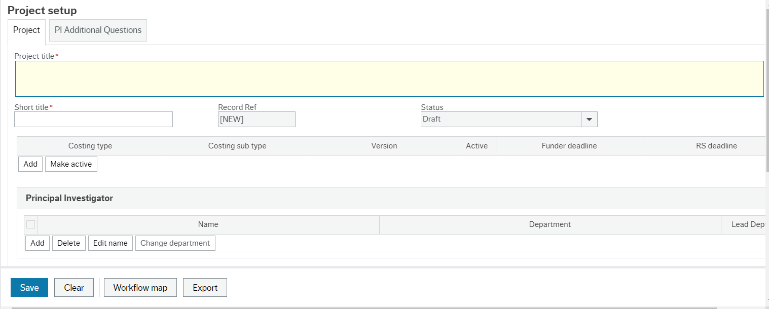
FMS Updates – Costing and Pricing

Slide 64
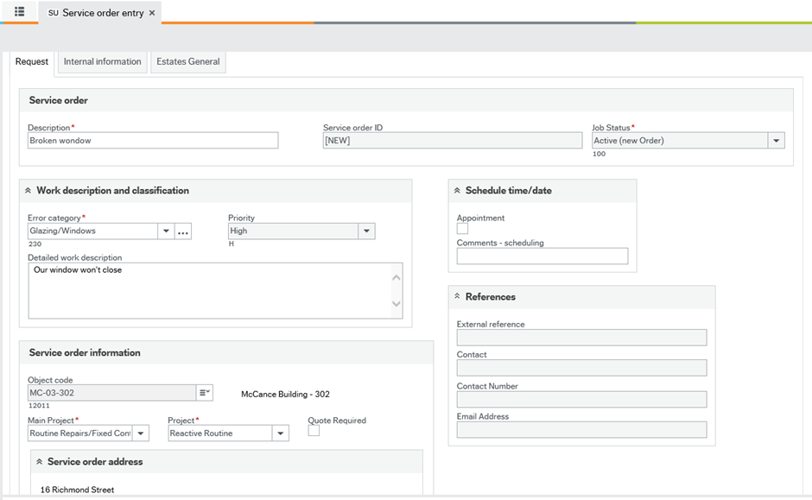
FMS Updates – Estates Service Management system

Slide 65
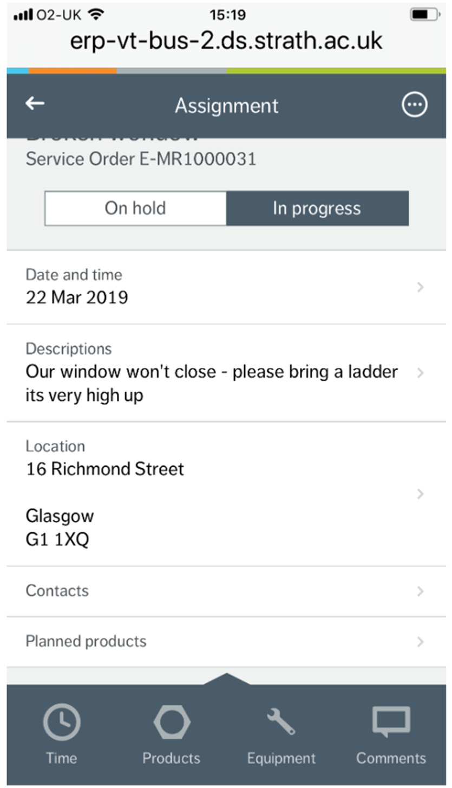
FMS Updates – Estates Service Management system
Jobs now go straight to an operative’s phone

Slide 66


FMS Updates - Knowly
New functionality under development
Provides ability to add some guidance directly on FMS
Will appear as

Slide 67
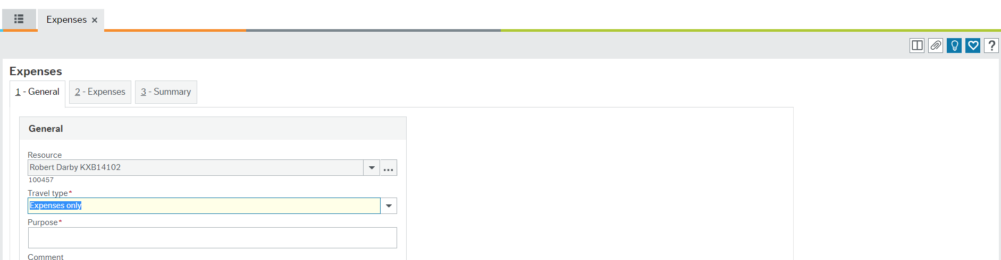
FMS Updates - Knowly

Slide 68

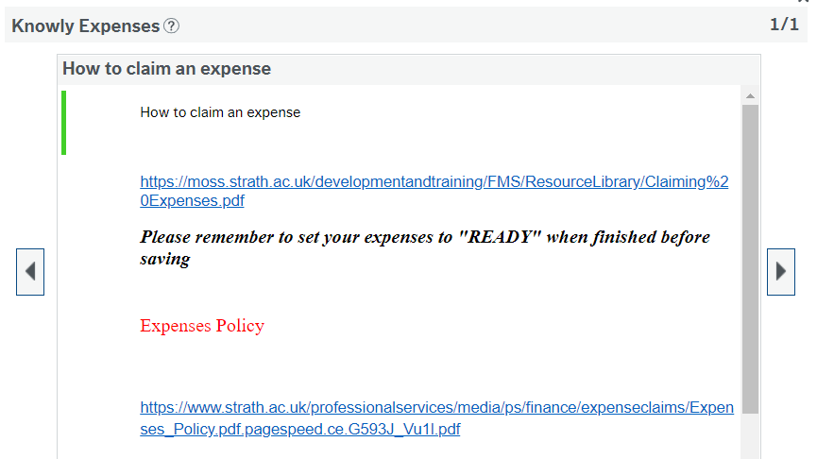
FMS Updates - Knowly
When click on opens new screen
new screen

Slide 69
FMS Updates – Alerts to SPM
Looking at alerts for SPMs
To be sent at beginning of each new month
Remind SPMs of their responsibilities
List sub project balances and links to Guidance

Slide 70
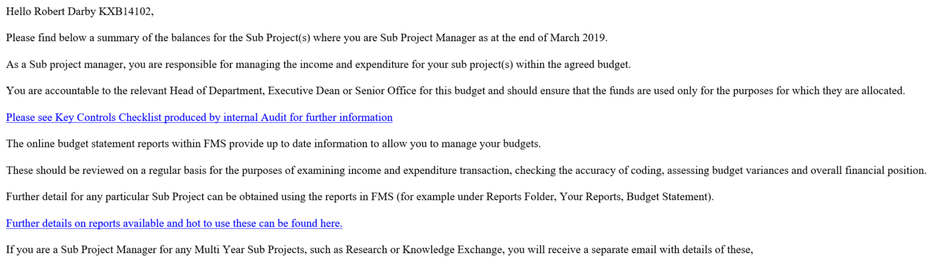

FMS Updates – Alerts to SPM –
DRAFT example

Slide 71

Training Update
Continued to deliver 1-1 sessions
Review of Training materials
Supporting Helpdesk implementation
Training courses for May and June will be released week beginning 15 April

Slide 72
Training Calendar : May
Monday | Tuesday | Wednesday | Thursday | Friday
 |  | 1st Intro to Finance | 2nd | 3rd Intro to Finance
Holiday | 7th Reporting | 8th Procure to Pay | 9th Intro to Finance | 10th
13th | 14th Expenses | 15th | 16th Journals & Virements | 17th Intro to Finance
20th Intro to Finance | 21st Reporting | 22nd Procure to Pay | 23rd | 24th
27th | 28th Expenses | 29th Intro to Finance | 30th | 31st Journals & Virements

Slide 73
Training Calendar : June
Monday | Tuesday | Wednesday | Thursday | Friday
3rd Procure to Pay | 4th | 5th Intro to Finance | 6th Reporting | 7th
10th Journals & Virements | 11th Expenses | 12th | 13th Intro to Finance | 14th
17th Intro to Finance | 18th | 19th Procure to Pay | 20th | 21st Reporting
24th | 25th Journals & Virements | 26th | 27th Expenses | 28th Intro to Finance

Slide 74

Workshops
Workshop 1:
New Supplier Process
Workshop 2 :
Key FMS Reports

Slide 75



