Slide 1


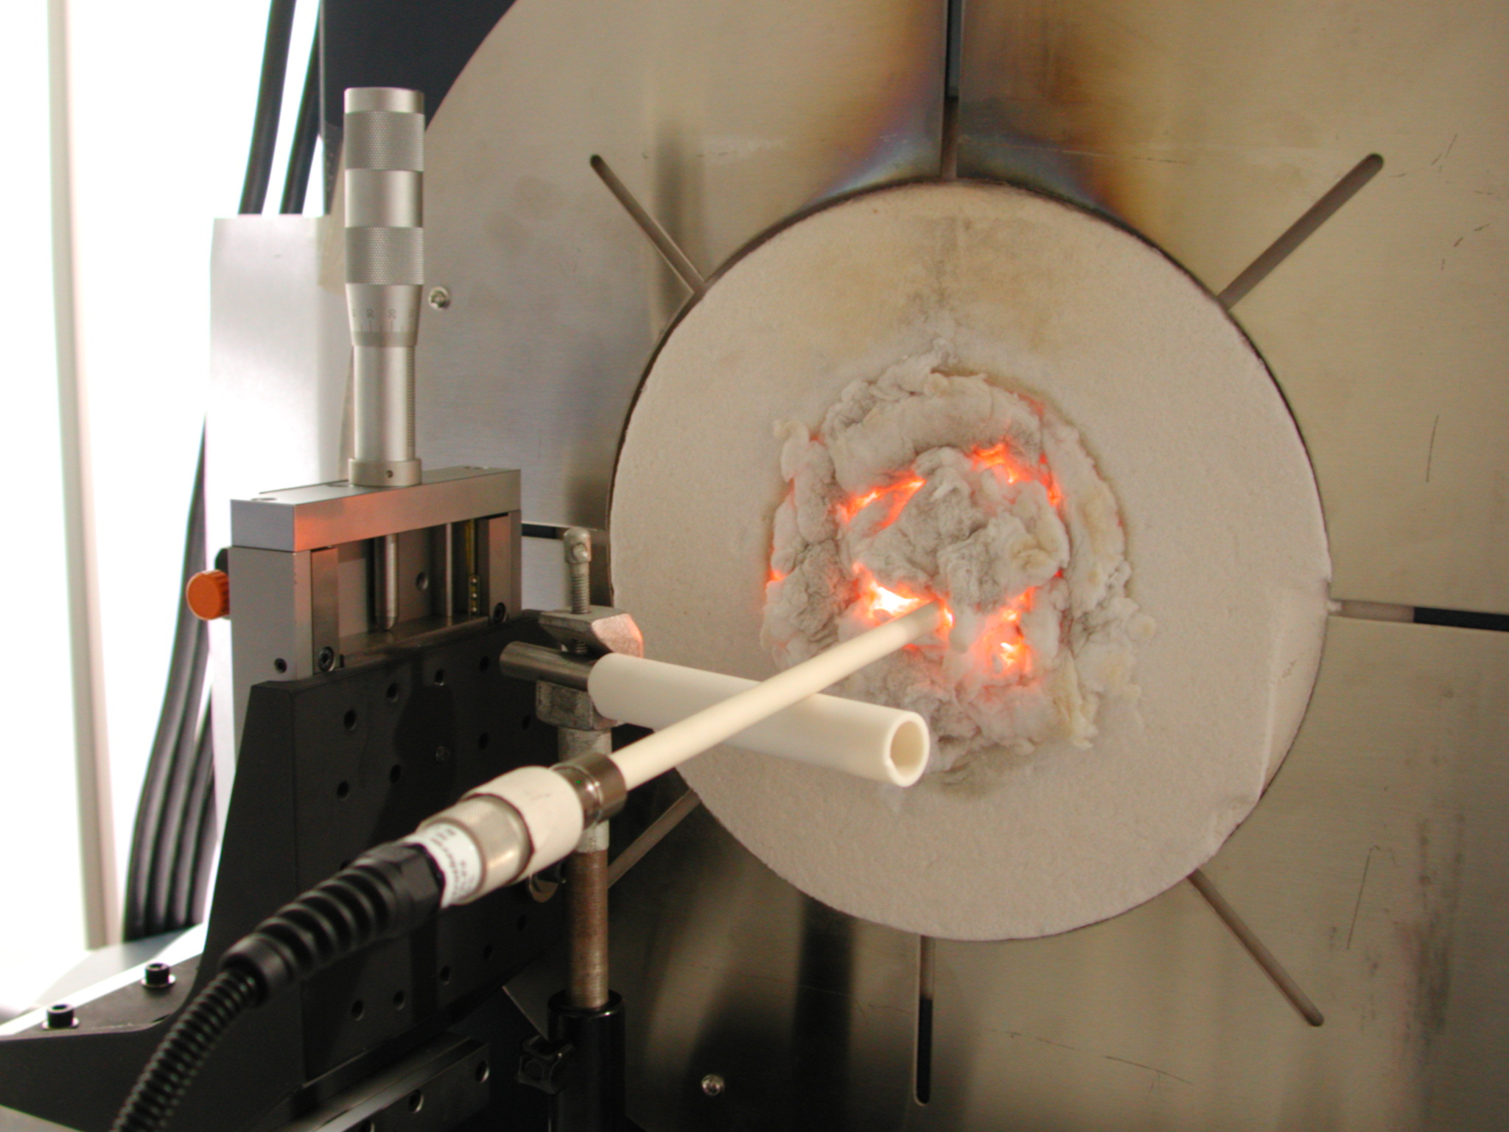
EMPRESS Workshop
NPL, April 18, 2018
Enhancing process efficiency through improved temperature measurement
“Low-drift contact temperature sensors to above 2000 °C”
WP1, Overview
frank.edler@ptb.de
PTB, WG: “Thermoelectrics”

Slide 2
WP 1
WP 1: Low-drift contact temperature sensors to above 2000 °C
Partners: PTB¹, JV¹, NPL¹, Elkem², MUT², STRATH², CCPI³
¹ Internal funded partner (National Metrology Institutes (NMI))
² External funded partner (Industry, University)
³ Unfunded partner
PTB Physikalisch-Technische Bundesanstalt, Germany
JV Justervesenet, Norway
NPL National Physical Laboratory, United Kingdom
Elkem Elkem AS Technology, Norway
MUT MUT Advanced Heating GmbH, Germany
STRATH University of Strathclyde, United Kingdom
CCPI CCPI Europe, United Kingdom
EMPRESS Workshop at NPL 2018

Slide 3
WP 1
Aim: Development of novel low-drift temperature sensors for enhanced production and temperature control
Objective: Development of novel sensors that have in-process traceable uncertainty of better than 3 °C at 1450 °C and better than 5 °C at T > 2000 °C.
3+1 Tasks: 1.1 – 1.4
3 new or optimized sensors
Testing under industrial conditions
Task 1.1: Optimized PtRh alloyed thermocouples
Task 1.2: Sapphire tube thermometer
Task 1.3: Graphite based thermocouples
EMPRESS Workshop at NPL 2018

Slide 4
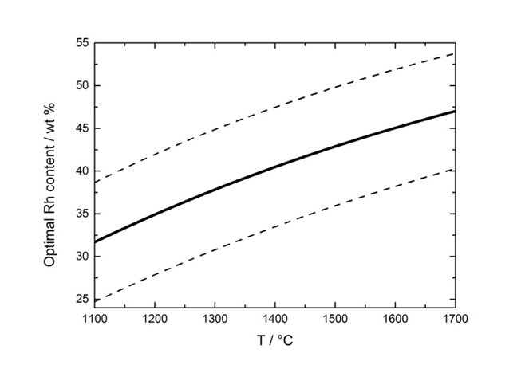
Task 1.1
Background
Conventional Pt/Rh thermocouples types S, R, B → thermoelectric instability (vapour pressure of Pt- and Rh-oxides) → historical „accidents“ rather than established on basis of optimization → modelling Pt-/Rh-oxide transport + experimental determination of optimum compositions
Model based on Pt, Rh oxide vapour transport (developed by NPL)
Pt, Rh oxide transport model: calculated wire composition for which evaporation of the oxides yields no change in wire composition (i.e. most stable)
Experimental investigation
at NPL and PTB
EMPRESS Workshop at NPL 2018

Slide 5
Task 1.1
Annealing of multi-wire thermocouples with different Ptx%Rh-alloys: x = 5, 8, 10, 13, 17, 20, 25, 30, 40 at different temperatures between about 1315 °C and 1480 °C (6000 hours)
Repeated measurements at Co-C (1324 °C) / Pd-C (1492 °C)
13
40
17
10
Annealing
Temperature 1315 °C 1350 °C 1400 °C 1450 °C
30
20
25
Drift rates
at Co-C
(1324 °C)
EMPRESS Workshop at NPL 2018

Slide 6
Task 1.1
Determination of a draft reference function of Pt40Rh/Pt6%Rh
 | Calibration points
CEM | 1000 ºC to 1500 °C by comparison, Ice point, Ga, In, Sn, Zn, Al, Ag, Cu, Co-C
KRISS | Ice point, Zn, Al, Ag-Cu, Ag, Cu, Fe-C, Ni-C, Co-C, Si-SiC, Pd-C, Ni, Pd
NPL | 0 to 700 °C by comparison, Ice point, Ga, In, Sn, Zn, Al, Ag, Cu, Co-C, Pd-C, Pt
PTB | Ice point, Ga, In, Zn, Al, Ag, Cu, Ni-C, Co-C, Pd, Rh-C, Pt-C, Pt
Protocol
Thermocouple constructed according to the procedure of the participating laboratory.
Electrical anneal of the wires at 1300 °C for 4 h
Assemble the wires in a twin-bore sheath
Annealing of the TC at 1350 °C for 200 h
emf measurements at the freezing point of Cu
(thermoelectric stability)
Calibration in the temperature range
0 °C to 1800 °C
Homogeneity check
NPL, PTB, CEM, KRISS
EMPRESS Workshop at NPL 2018

Slide 7
Task 1.1
Calibration values by the participants Deviations from 6th order polynomial
EMPRESS Workshop at NPL 2018

Slide 8
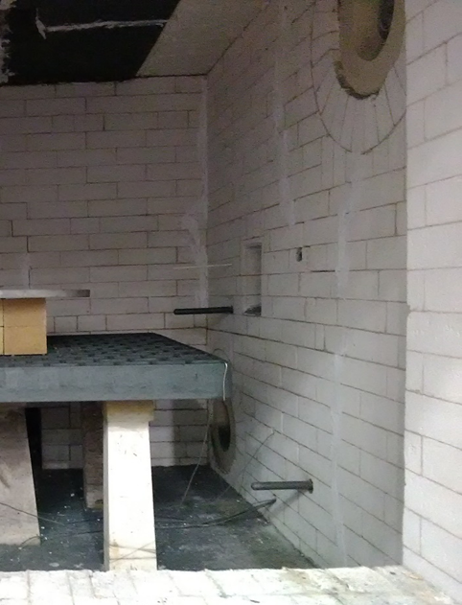
Task 1.1 (1.4)
Test under industrial conditions at AFRC and MUT (Advance Heating Systems)
1602.5 °C
9 days
stable temperature indications
offset: ≈ +25 °C
EMPRESS Workshop at NPL 2018

Slide 9
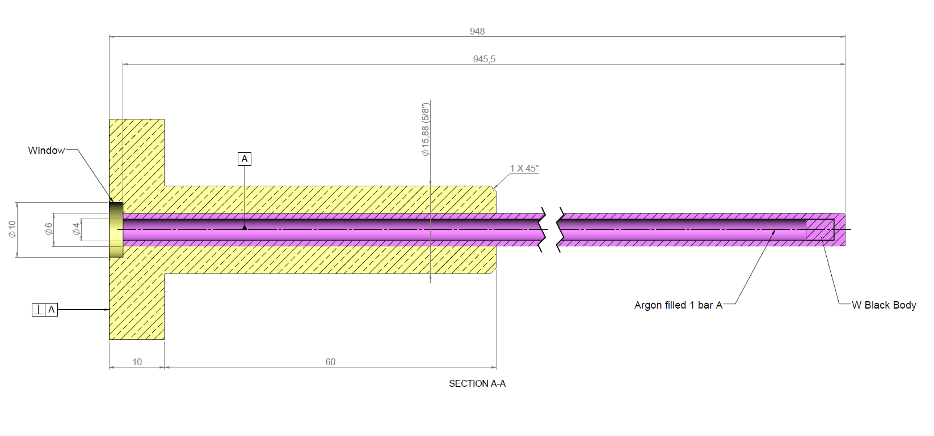
Task 1.2
Development of a sapphire tube thermometer
A prototype thermometer was developed based on thermal radiation.
It consists of a sensing element (blackbody), which is placed inside a sapphire tube with suitable optics channeling the thermal radiation on to a light detector (electronics)
Based on the Planck radiation law, a model for the signal as a function of temperature was developed.
Tungsten filament
EMPRESS Workshop at NPL 2018

Slide 10
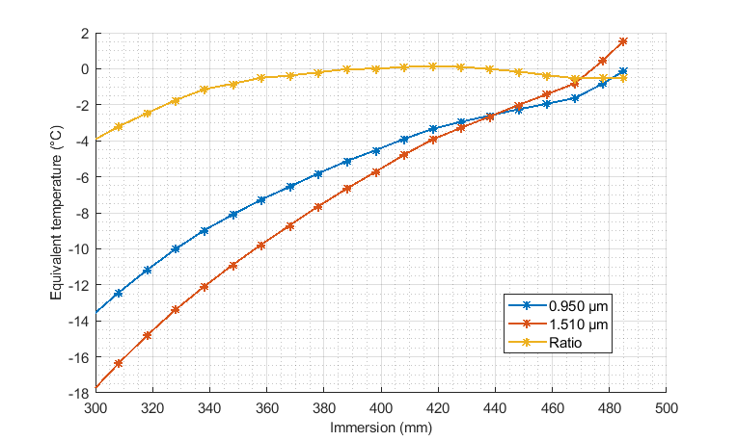
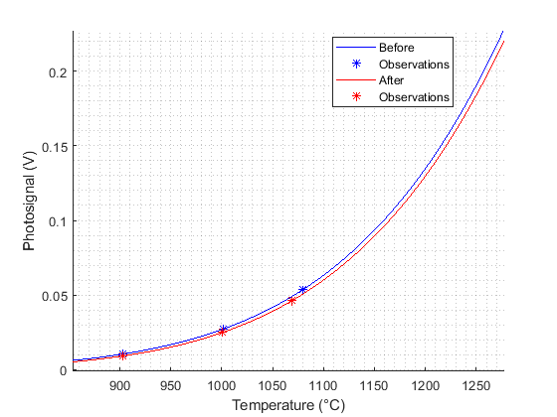
Task 1.2
Main problem:
the temperature
profile along the
tube disturbs
the signal
Scattering of signals
Misalignment
Sodium heatpipe
Temperature differences between a thermocouple and a sapphire tube setup, using two two detectors working at different wavelengths
and their ratio
Calibration curves from Sakuma-Hattori fits:
before and after the trial at ELKEM
EMPRESS Workshop at NPL 2018

Slide 11
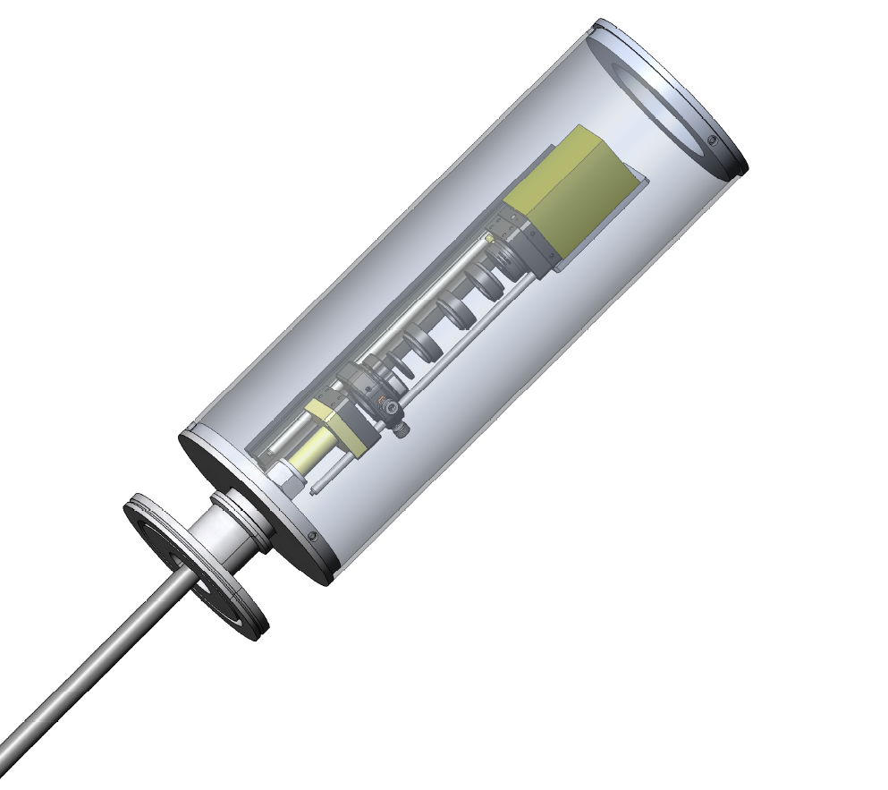
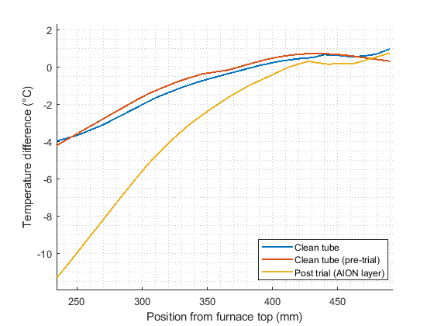
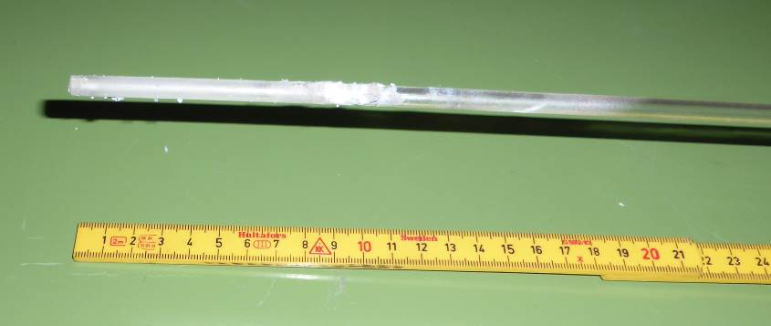
Task 1.2 (1.4)
Test under industrial conditions at ELKEM
Furnace: Si solidification facility
- Temperature cycles every 24 h: room temperature,
pre-heating at 1420 °C, 1600 °C, cooling procedure.
- Combined uncertainty at ELKEM: 9.2 K
appearance of the
sapphire tube after
the measurements
different immersion profiles (compared with a TC)
SEM picture
Problem with emissivity →
Dual-band measurements
EMPRESS Workshop at NPL 2018

Slide 12
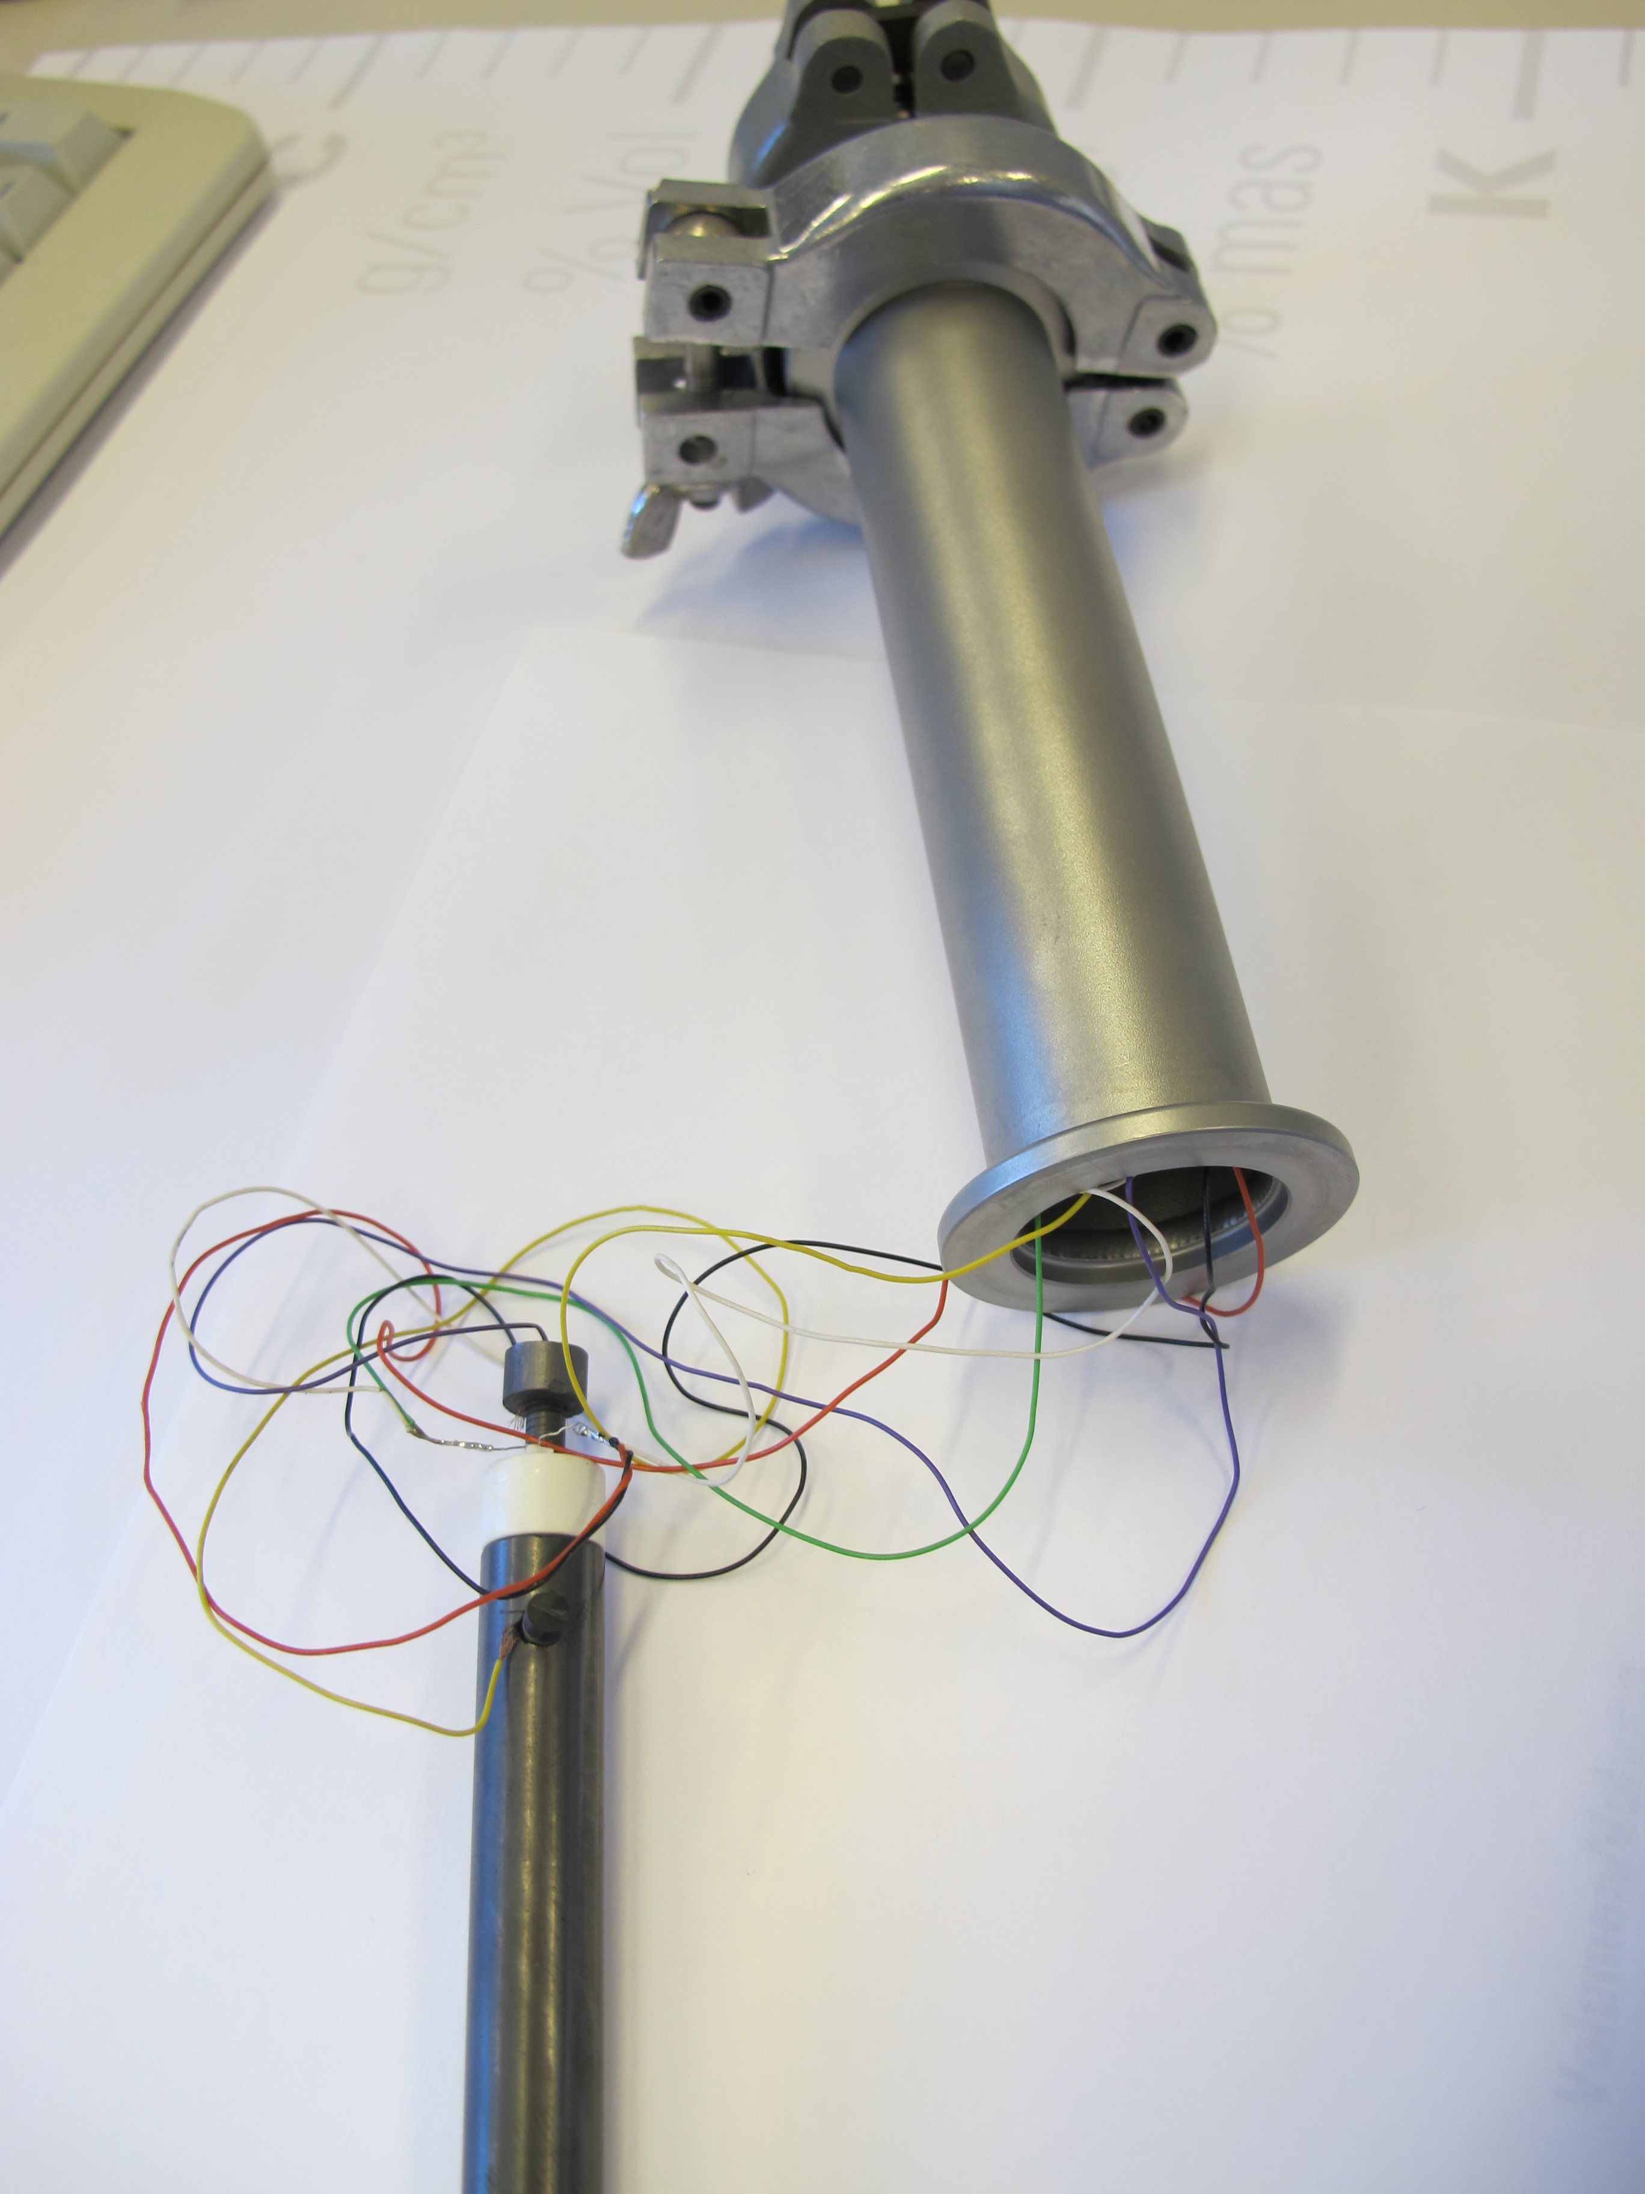
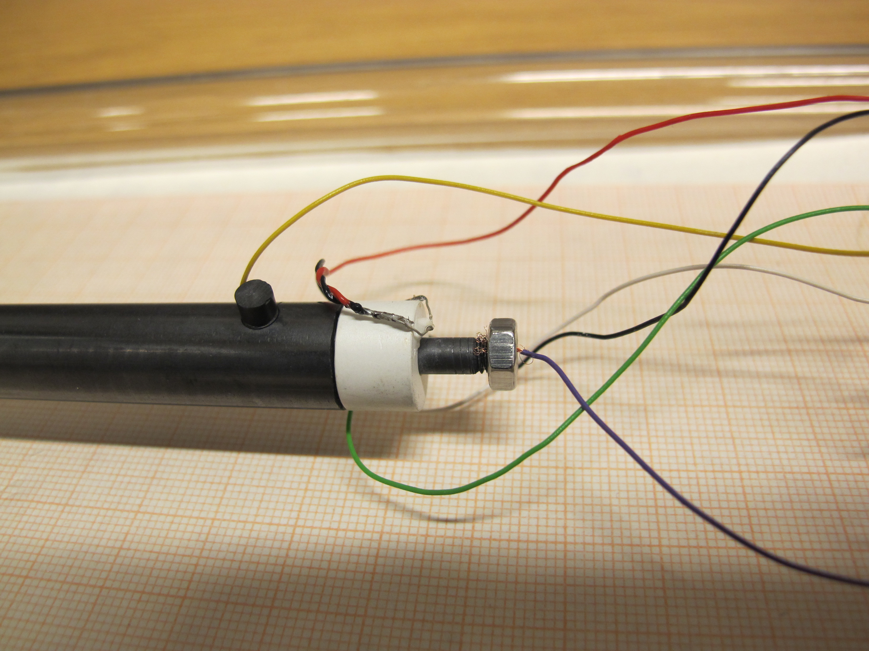
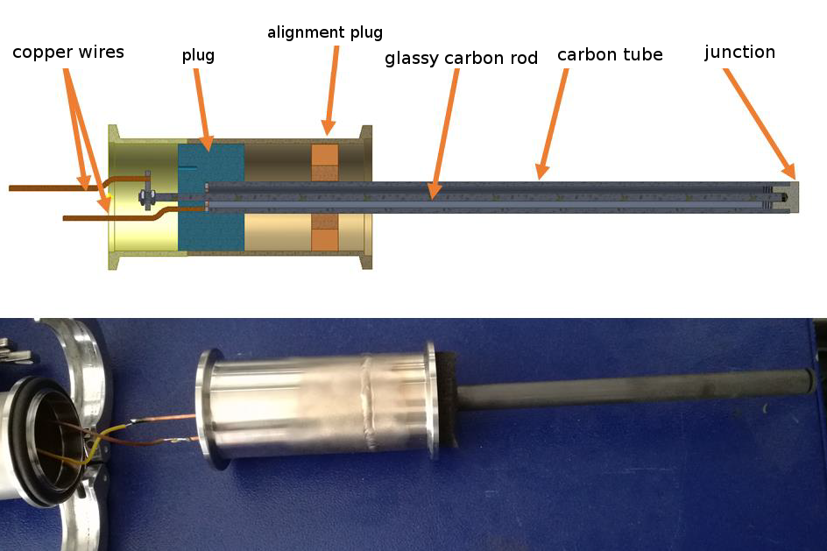
Task 1.3
Development of carbon thermocouples
Materials:
Sigrabond®
Sigrafine® R7510G
Sigrafine® R7660P010
Tubes Rods
∅ 12x8 mm ∅ 4 mm
L: 600 mm L: 600 mm
Sigradur® (Glassy carbon)
Rods: ∅ 4 mm, L: 600 mm
Special requirements of the construction due to
the use of non-metal thermoelement:
Pt 100
Rod
Tube
Flange
rod
tube
Head design MUT
EMPRESS Workshop at NPL 2018

Slide 13
Task 1.3
emf/temperature relationship
(room temperature)
Thermocouple: C/C 76/75-N01
1500 °C 1950 °C
R7660/R7510
not suitable
above ≈1500 °C
EMPRESS Workshop at NPL 2018

Slide 14
Task 1.3
Sigradur®/R7660
moderate thermoelectric stability up to 1500 °C
(combinations of Sigradur®, within 3 K, 55 h,
cycling room temperature ↔ 1500 °C)
irreversible changes at higher temperatures
(above 1600 °C: increasing emfs)
prone to EMI (no insulation)
lack of thermoelectric stability and sufficient reproducibility
EMPRESS Workshop at NPL 2018

Slide 15
Task 1.3
Stop irreversible drift?
Drift reversal at 1900 °C
1700 °C
1820 °C
EMPRESS Workshop at NPL 2018

Slide 16
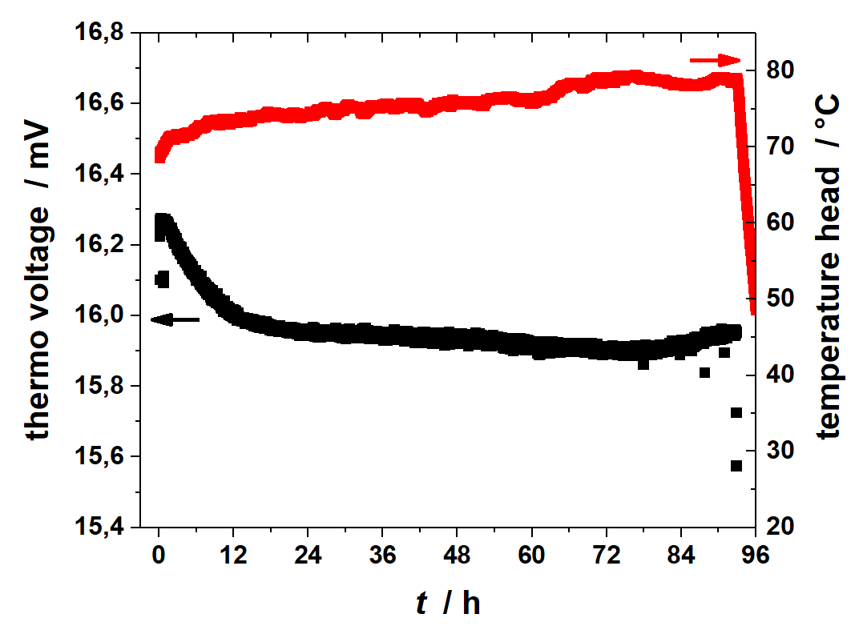
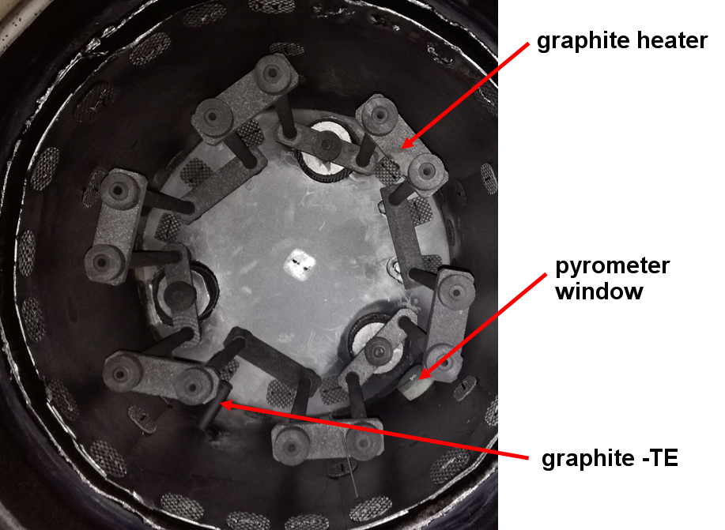
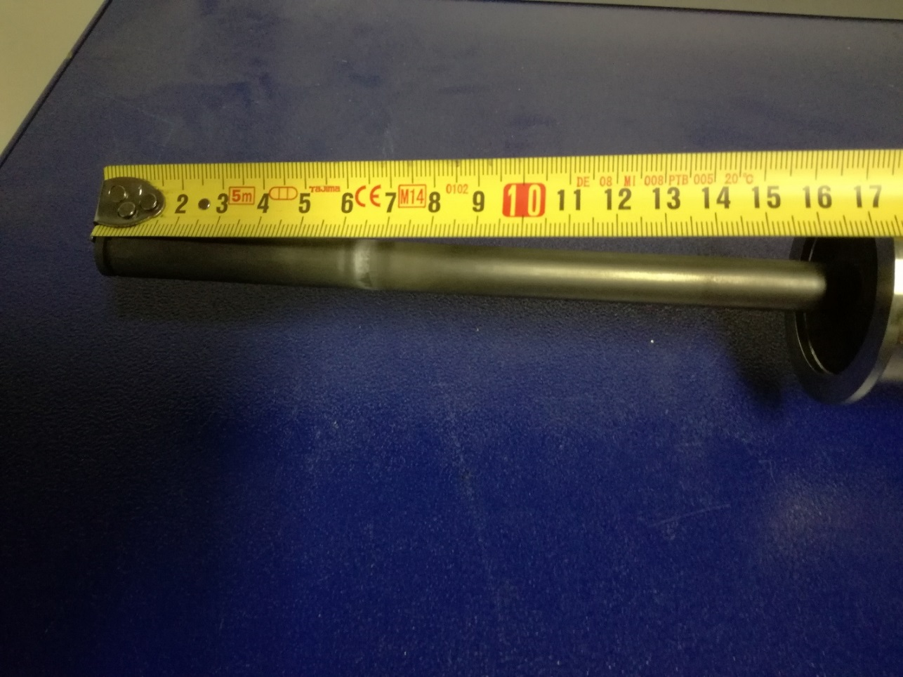
Task 1.3 (1.4)
Test under industrial conditions at MUT
Sigradur®/R7660:
1500 °C, 100 h (15.93 ± 0.03) mV
1600 °C, 10 h (16.50 ± 0.03) mV
EMPRESS Workshop at NPL 2018

Slide 17
WP 1
Summary
Task 1.1: Model of emf drift rate related to dS/dc developed
Most stable combination of PtRh alloys identified (experimentally)
Preliminary reference function of Pt40%Rh/Pt6%Rh
(6th order, full temperature range, 0 °C – 1800 °C)
Task 1.2: Model function temperature to signal developed (Sakuma-Hattori equation)
Three different tube design tested
Prototype calibrated (JV) and tested at ELKEM (1600 °C)
Drift effects → dual-band detection (less influence of emissivity)
    Theoretical evaluation of dual-band detection + practical tests (JV + ELKEM)
Task 1.3: Suitable thermocouple design developed (head)
Four different graphite materials tested
Insufficient thermoelectric stability at 2000 °C
Combinations with glassy carbon most promising (T < 1700 °C)
Task 1.4: Performed with satisfying results in reduced temperature ranges
EMPRESS Workshop at NPL 2018

Slide 18
Questions?
Physikalisch-Technische Bundesanstalt
Braunschweig and Berlin
Abbestraße 2-12
10587 Berlin
Frank Edler
E-Mail: frank.edler@ptb.de
www.ptb.de
Stand:04/18

