Slide 1
A collaborative project between
A Practical Johnson Noise
Thermometer
Metrosol Limited & NPL

Slide 2

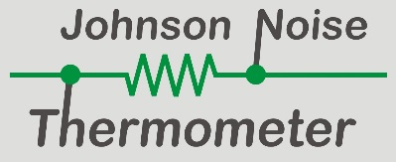
The Need for a Better Thermometer
↑ There is a demand for better thermometers
↑ Current thermometers drift, especially in harsh environments
↑Why and what’s the solution?

Slide 3
Current (secondary) Thermometers
Things other than
temperature can affect
this property
Measure property affected by temperature
Calibration
Temperature scale
ITS-90
True thermodynamic temperature

Slide 4
Johnson Noise (primary) Thermometer
Measure Johnson Noise
Fundamental
Equation
True thermodynamic temperature

Slide 5
Using Johnson Noise to Make a Thermometer
RMS

Slide 6

The Johnson-Nyquist Equation
$$V_{n}=\sqrt{4kTR∆f}$$
$V_{n}$ = the RMS voltage
$k$ = Botzmann’s constant
$T$ = the thermodynamic temperature of the resistor
$R$ = the resistance of the resistor
$∆f$= the measurement bandwidth
Problems:
$V_{n}$ extremely small (at limits of measurement)
$∆f$ hard to define/determine
An innovation project by ……

Slide 7
The Johnson-Nyquist Equation
$$T=\frac{1}{4k} \left\{{\frac{V_{n}^{2}}{R}}/{∆f}\right\}$$
$V_{n}$ = the RMS voltage
$k$ = Botzmann’s constant
$T$ = the thermodynamic temperature of the resistor
$R$ = the resistance of the resistor
$∆f$= the measurement bandwidth
Problems:
$V_{n}$ extremely small (at limits of measurement)
$∆f$ hard to define/determine
An innovation project by ……

Slide 8
Prior Art Johnson Noise Thermometer
Amplifiers A & B amplify the same signal from the sense resistor but add their own noise
The correlator supresses uncorrelated noise and detects only the signal common to both channels i.e. the sensor’s Johnson noise
This allows us to measure the extremely small Johnson noise signal provided the correlation time is sufficiently long
An innovation project by ……

Slide 9
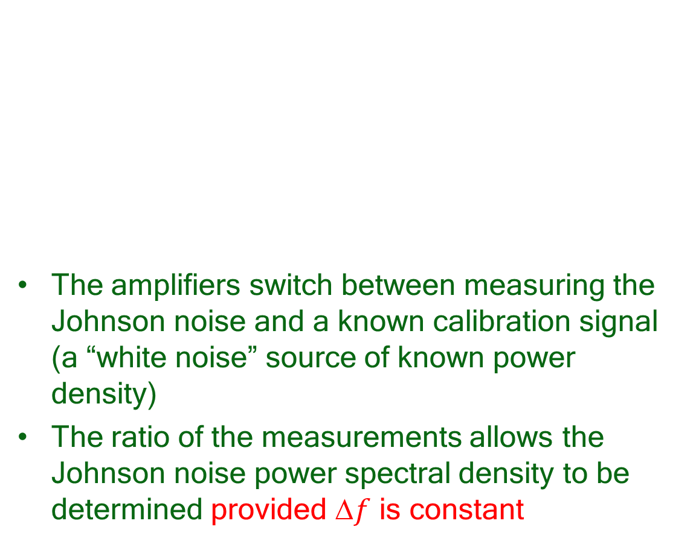
Prior Art Johnson Noise Thermometer
The amplifiers switch between measuring the Johnson noise and a known calibration signal (a “white noise” source of known power density)
The ratio of the measurements allows the Johnson noise power spectral density to be determined provided $f$ is constant
An innovation project by ……

Slide 10
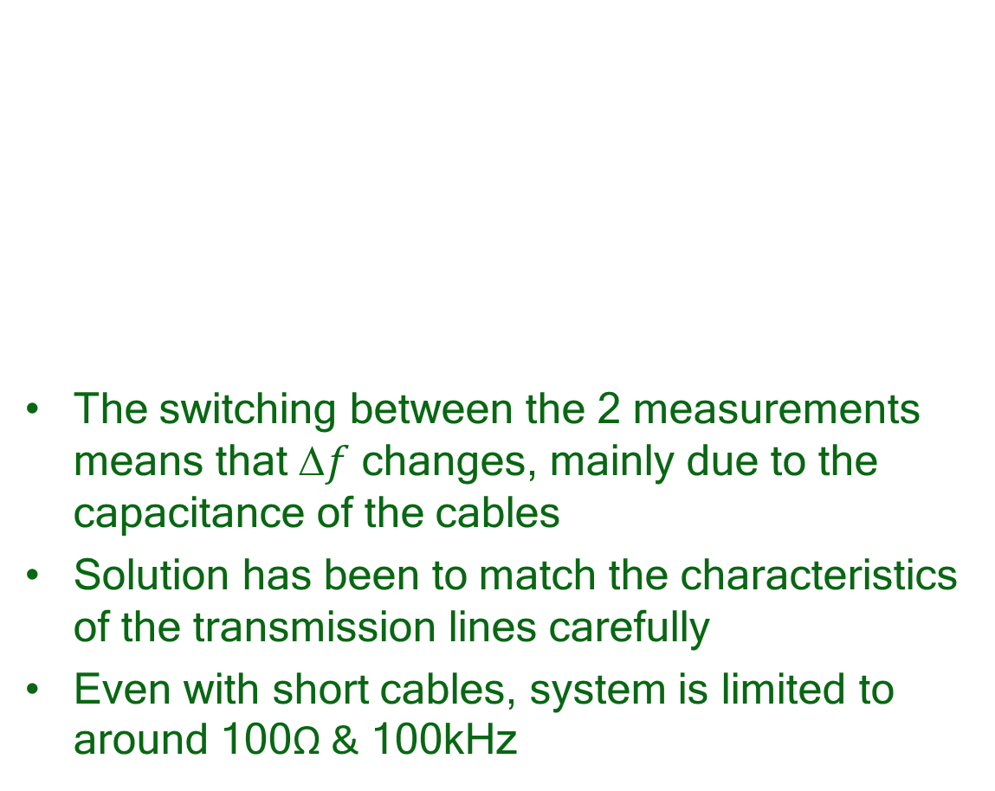
Prior Art Johnson Noise Thermometer
The switching between the 2 measurements means that $f$ changes, mainly due to the capacitance of the cables
Solution has been to match the characteristics of the transmission lines carefully
Even with short cables, system is limited to around 100Ω & 100kHz
An innovation project by ……

Slide 11
Metrosol Johnson Noise Thermometer
Calibration signal injected as current, which generates a calibration voltage in the sensor
The Johnson noise & calibration signal experience the same frequency response
The signals are subsequently separated completely using digital signal processing
An innovation project by ……

Slide 12
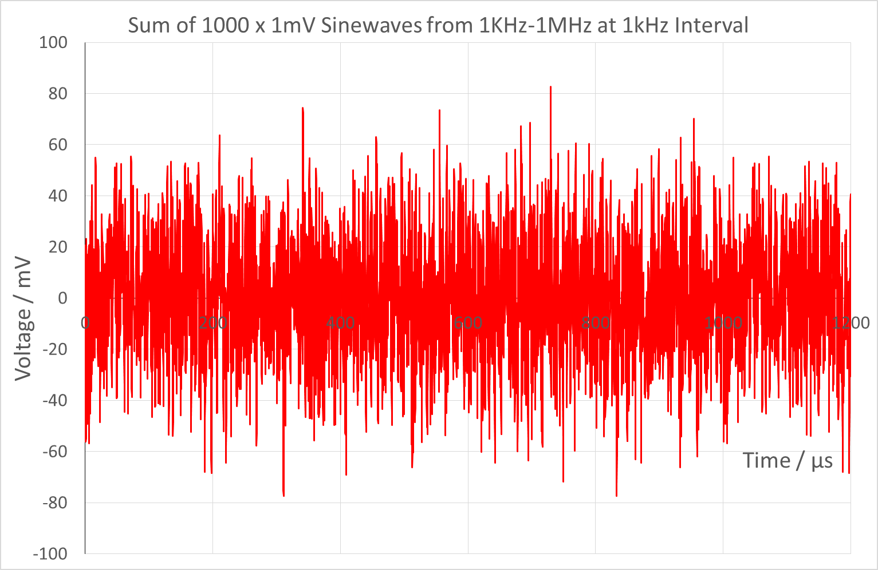
Pseudo Random Noise Calibration Signal

Slide 13
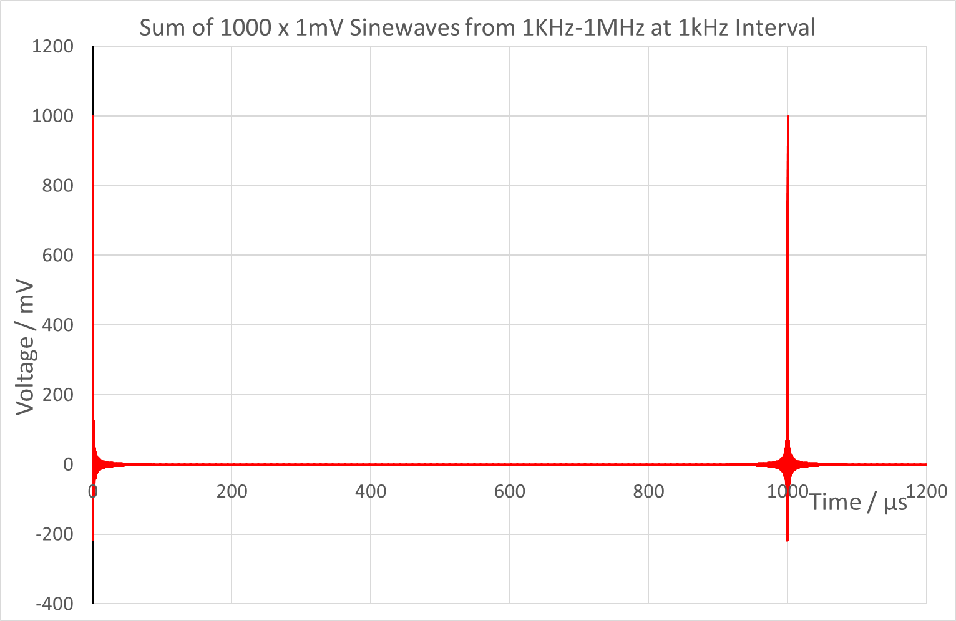
Pseudo Random Noise Calibration Signal

Slide 14
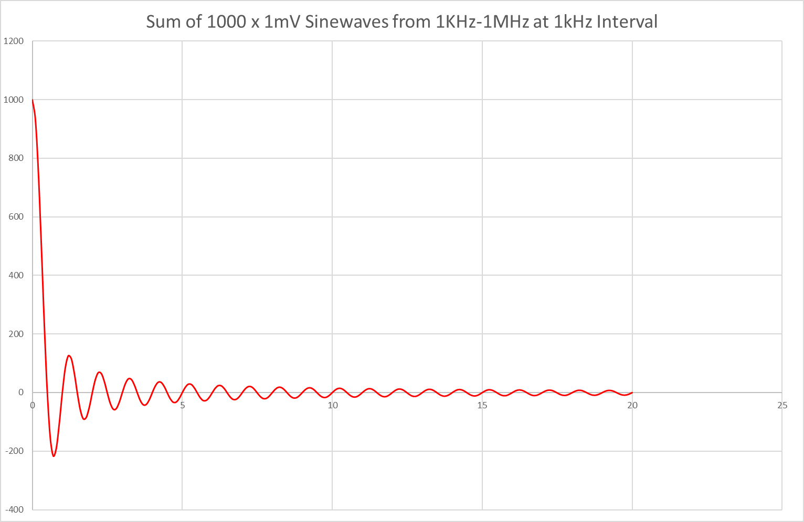
Pseudo Random Noise Calibration Signal

Slide 15
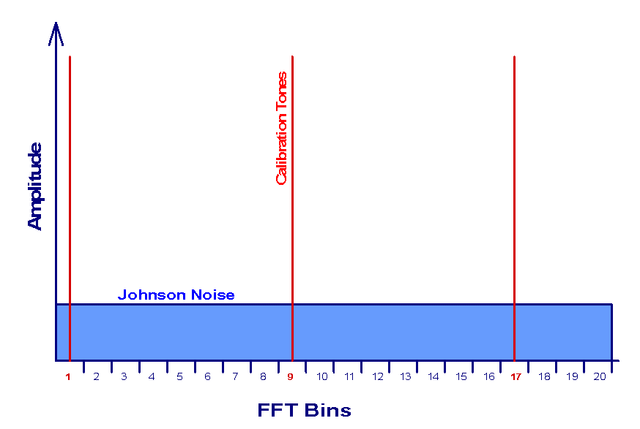
Pseudo Random Noise Calibration Signal

Slide 16
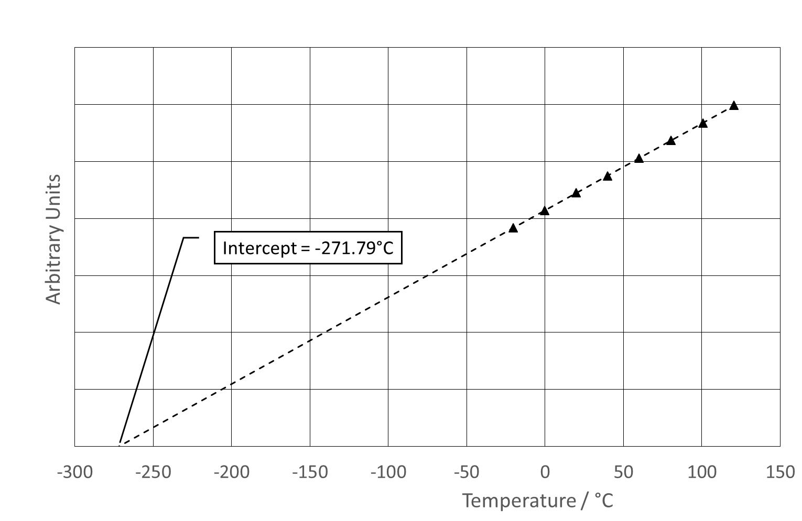
Results = Linearity & Offset

Slide 17
Results: Accuracy

Slide 18
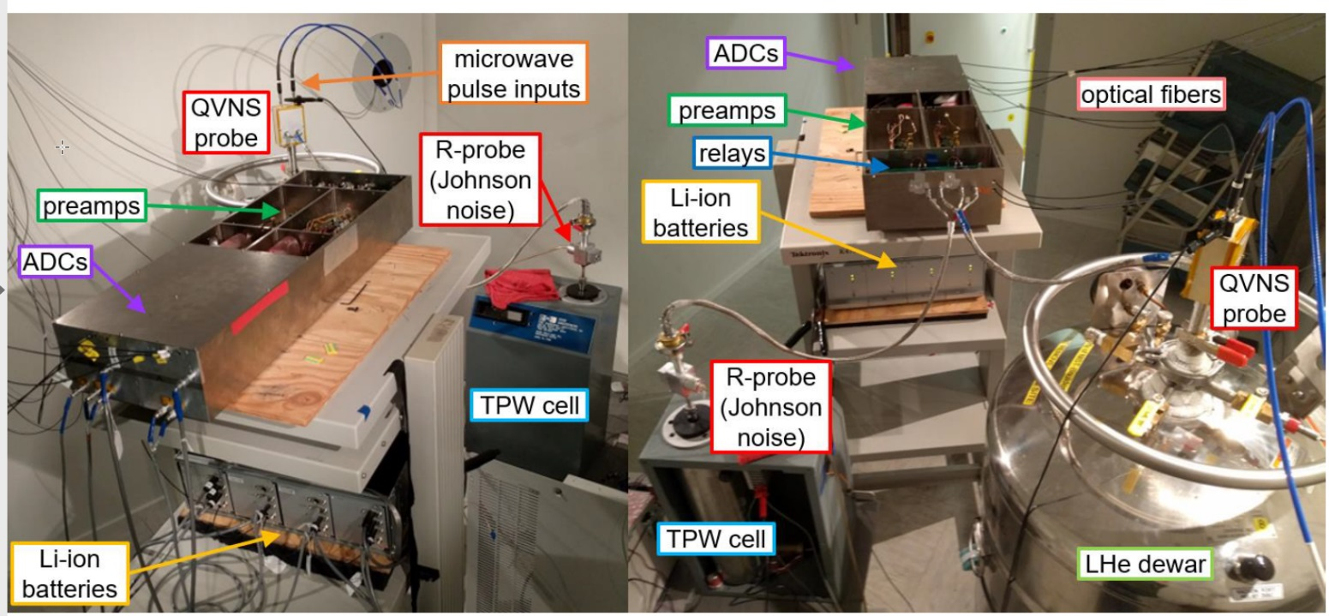
Prior Art JNT (at NIST)
Prior art: high cost, room sized experiments operating in a screened room:

Slide 19
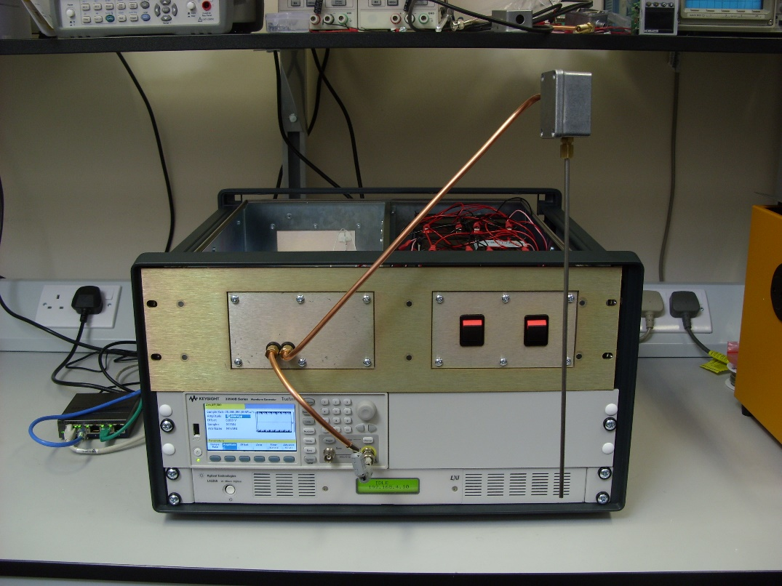
First “Practical” Johnson Noise Thermometer
Proof of principal prototype, working in normal laboratory environment:

Slide 20
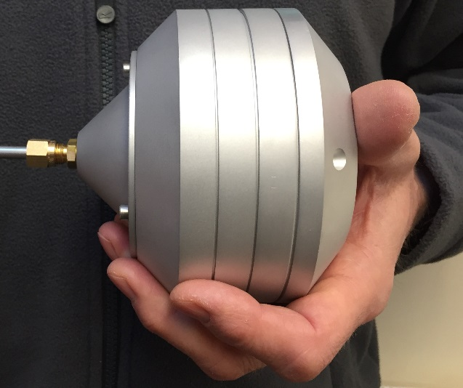
Second Stage Prototype “JNT2”
JNT1: 35kg, 70L & -20 to +120°C to…
JNT2: 1kg, 1L & -100 to 1,000°C:

Slide 21
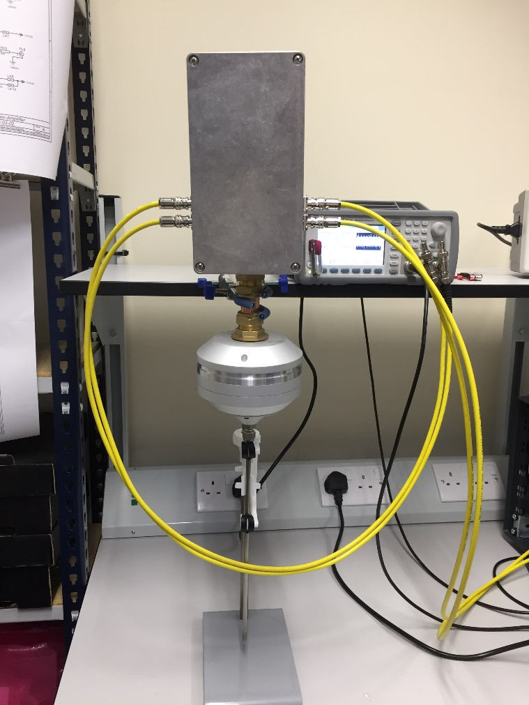
Progress So Far

Slide 22
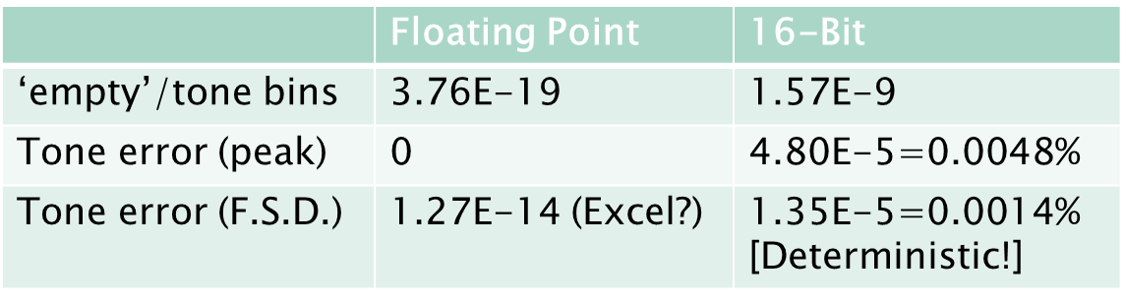
Uncertainty Budget: waveform quantisation
Create PRN data file
Quantise to 16-bits (1 in 65536 = 0.0015%)
Run data through FFT + FD correlator
Calculate:
  Ratio: “empty” FFT bins/tones bins
  Error in tone bins (peak & standard deviation)

Slide 23
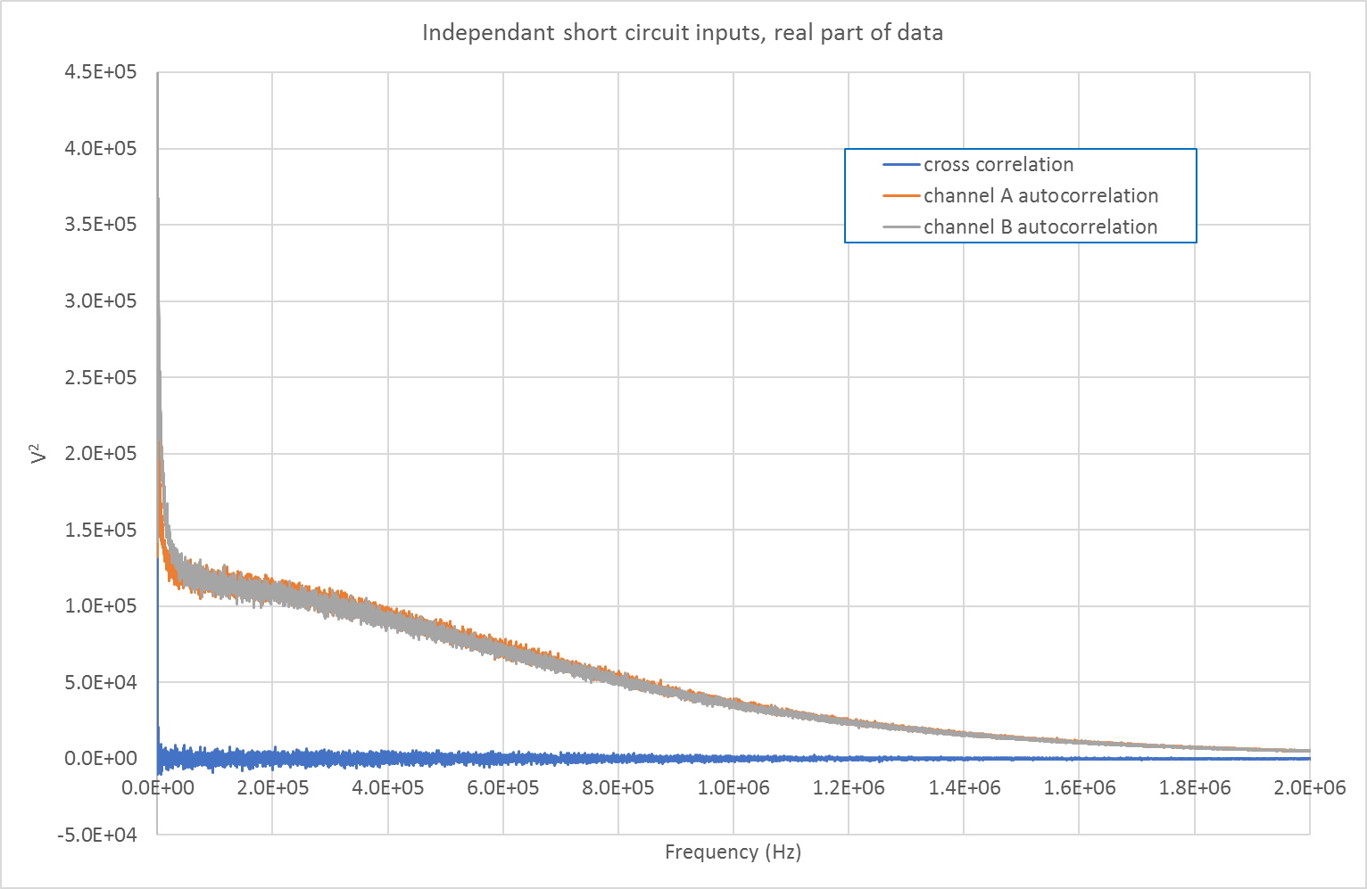
Initial Promising Results
Correlator “eliminates” amplifier noise:

Slide 24
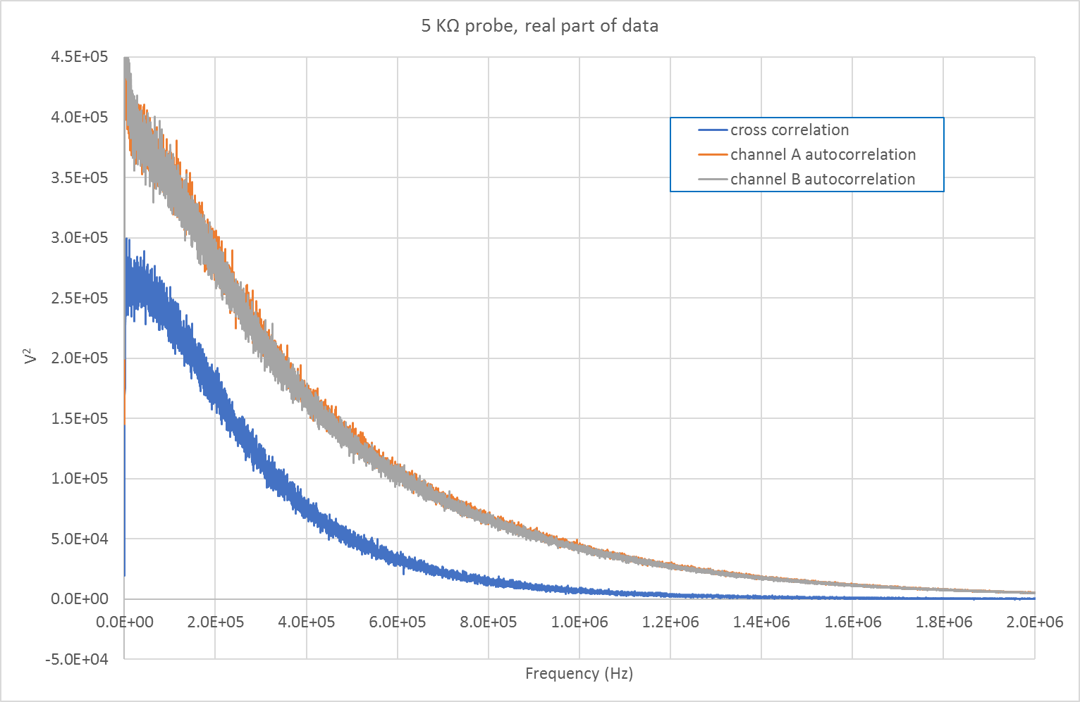
Initial Promising Results
Correlator “eliminates” amplifier noise:

Slide 25


Project Progress
3 Year Project: Oct 2017 to Sep 2020
Technical progress on track
Starting to engage with market
Metrology partner:
Civil Nuclear partner:

Slide 26
A collaborative project between
For more information, visit….
www.johnson-noise-thermometer.com
www.facebook.com/johnsonnoisethermometer/
Metrosol Limited & NPL

